Slide 1
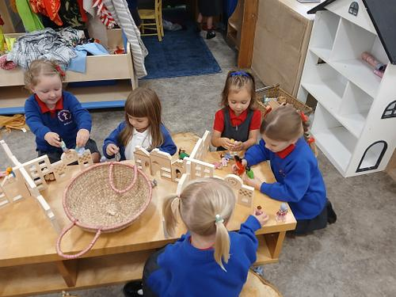
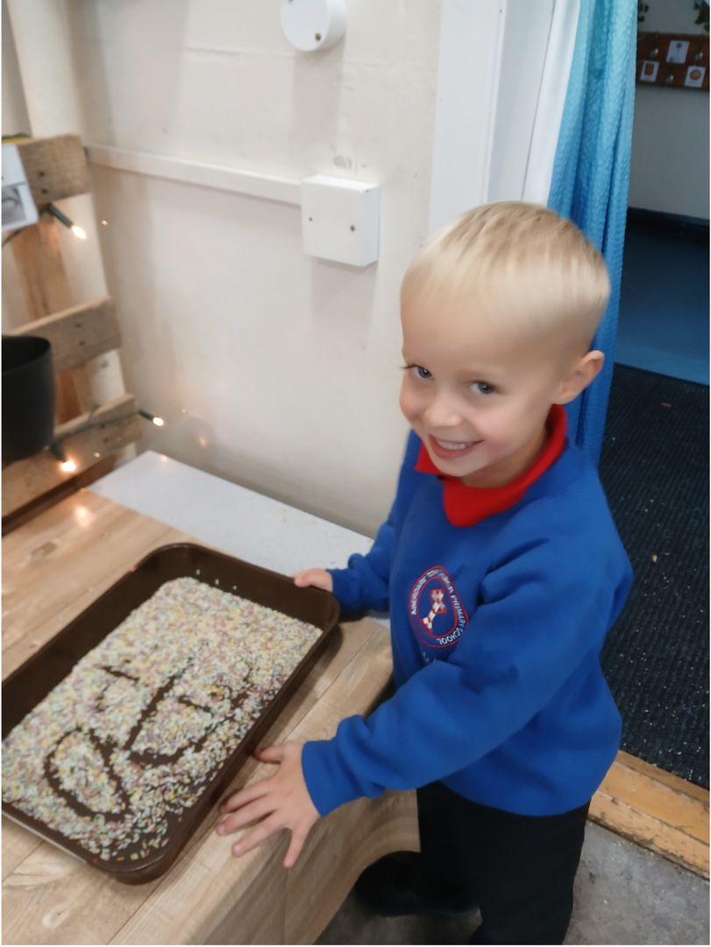

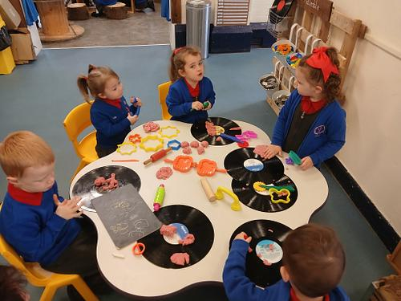
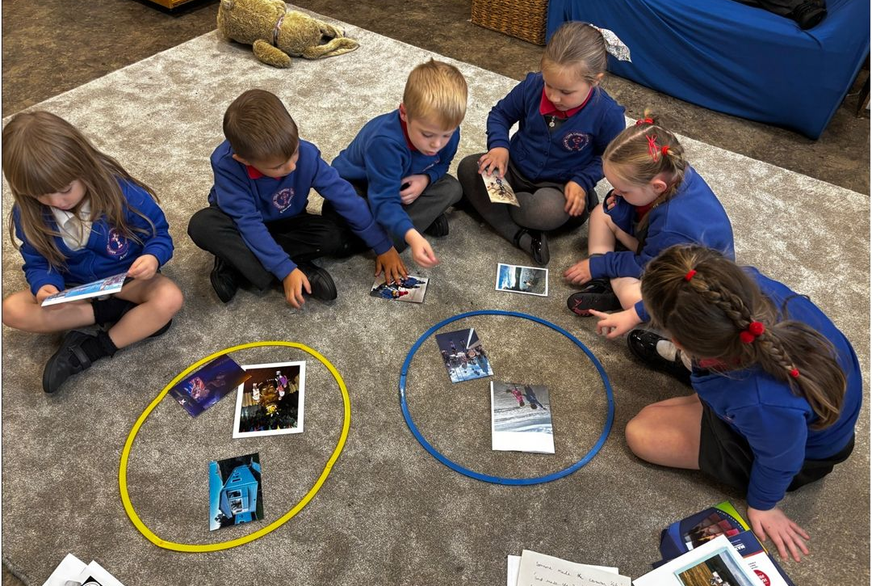
Croeso i Butterflies
Reception

Slide 2
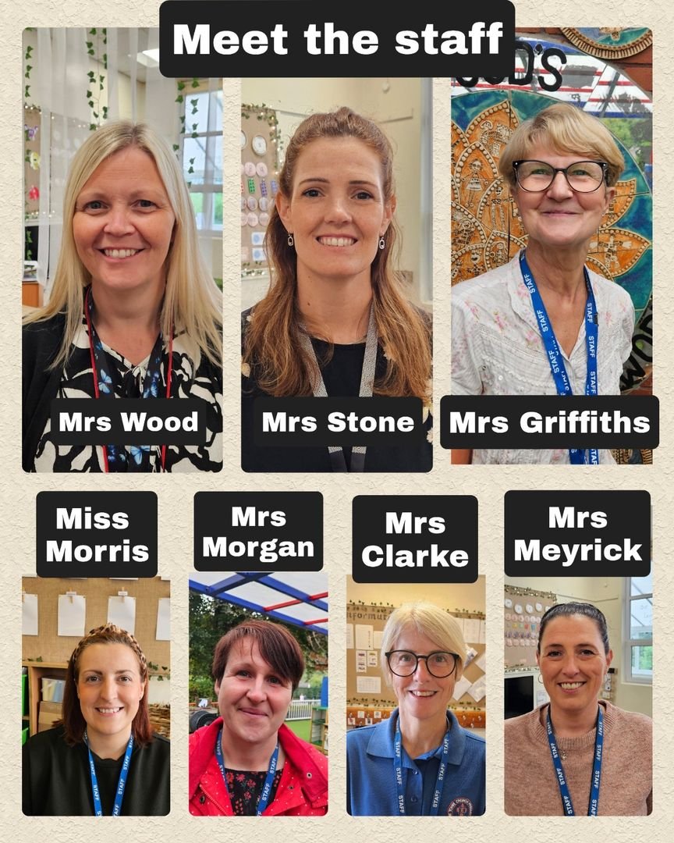
Staff in Progression Step 1
(Nursery & Reception)
Teacher:
Mrs Wood
HLTA
Mrs Stone
Teaching Assistants:
Mrs Clarke, Miss Morris, Mrs Morgan
Mrs Griffiths, Mrs Meyrick

Slide 3
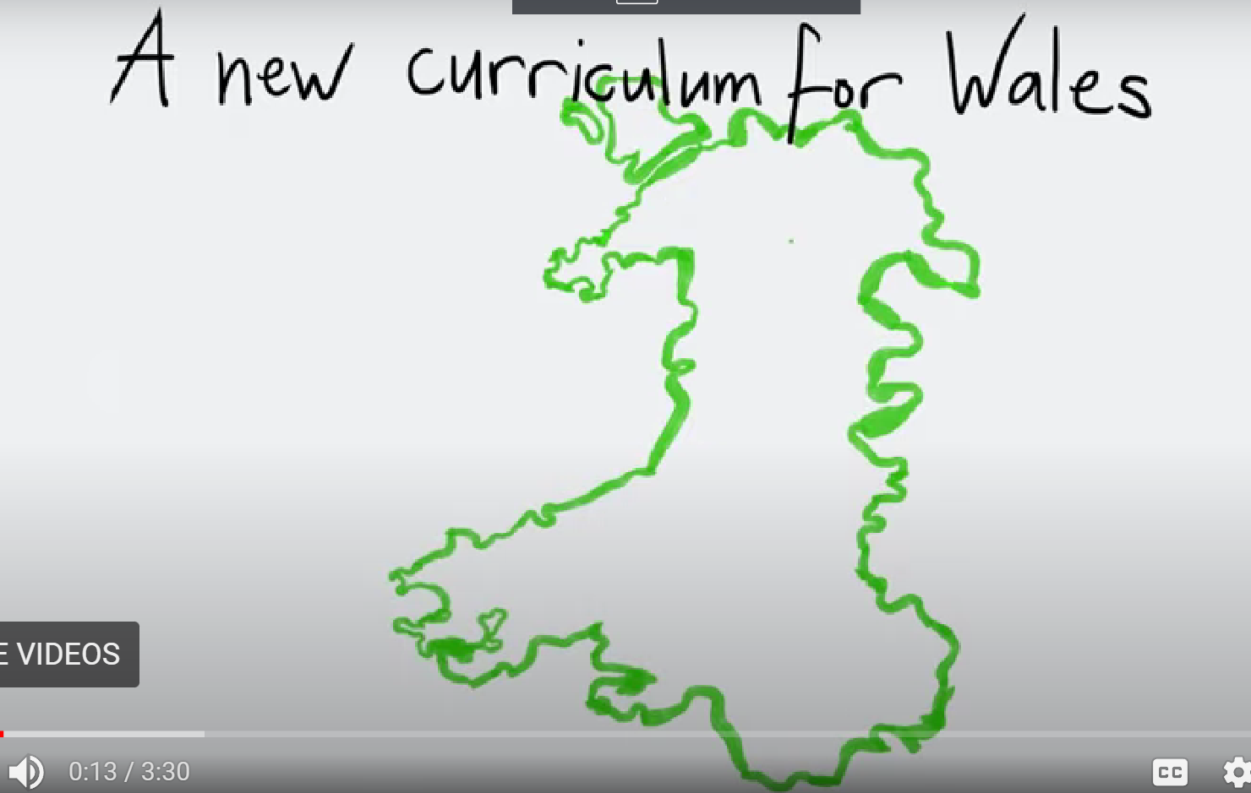

Slide 4



Slide 5



Slide 6



Slide 7
Our Town Church School Vision
Our Faith, our Values and our Christian ethos are the foundations of our school. Our school mission statement is:
To encourage all children and adults to grow in confidence and to understand that they can reach for the stars.
To ensure that everyone feels valued and knows that they are part of God’s family.
To promote pride in our school family and our work.
To develop strong links between our school, our families, our church and the wider community.
To develop a love of learning that will last our whole lives and to share that love with those we meet.
This Mission Statement was created by the children of Town Church Primary with staff and Governors and approved by the Full Governing Body

Slide 8
Our 2025/26 School Improvement Priorities
To improve standards in pupil independence and effectiveness
To improve standards in reading and spelling
To improve standards of mental arithmetic and to further embed the CPA (Concrete, Pictorial, Abstract) approach
To improve standards in Welsh oracy
To further develop RVE (Religion, Values and Ethics) and our awareness and understanding of other faiths.

Slide 9
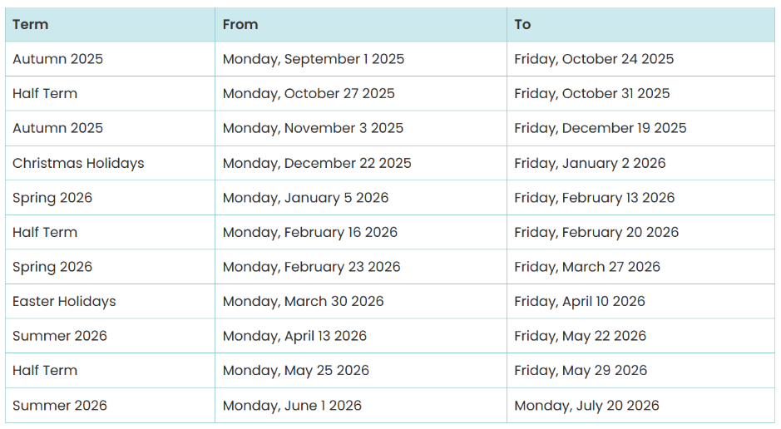
Term Start and Finish Dates

Slide 10
Attendance
Although we understand that children become unwell and we would not want yo to send a sick child to school. Good attendance is a key factor in their progress. A child with an attendance of 90% misses the equivalent of 1 school day every two weeks.
97% attendance | 5 days missed
95% attendance | 10 days missed
90% attendance | 20 days missed
85% attendance | 30 days missed
80% attendance | 40 days missed
75% attendance | 50 days missed
70%attendance | 60 days missed
65% attendance | 70 days missed

Slide 11
Inquiry Based Learning
Autumn Term:
What makes places special?
Can anybody be a superhero?
Spring Term:
What happens when we step into a story?
Summer
Where does our food come from?

Slide 12
Start/End of Day
Morning drop off
Please drop off your children at the main school gate, located on Wind Street. We ask that those parents bringing their children to school in cars be considerate as the entrance can be busy in the mornings and the afternoons. Please also ensure that the bus bay is left unoccupied as this is reserved for the buses bringing our children from further afield. A member of staff will unlock the gate at 8:45am and will be there to welcome everyone until they lock the gate at 9:00am. Promoting independence, the children will line up on the Foundation Phase yard at 9:00am and be led into their separate classes and cloakrooms.
Afternoon pick up
The gates will be opened by 3:10pm. Please collect your children from side door of the nursery at 3:15pm. If you would like to speak to us, please wait until all children have been safely dismissed. Children not picked up by 15:25 will be taken to the main office as we often have training/meetings that start straight after school and run into the evening. Early collections will always be via the main office.

Slide 13
What should my child bring to school?
School Uniform
This must be worn every day. Please ensure all items are clearly labelled with your child’s name as they can be easily lost or misplaced and this helps us to reunite them with their owner.
Please also ensure that children wear appropriate footwear and bring a coat to school with them. The weather during the Autumn term is always unpredictable and we try to get the children outside at playtime and lunchtime whenever possible. We also engage in outdoor learning opportunities whenever these link to our inquiries and so a warm/ waterproof coat ensures that the children can engage in their learning whilst still being dry and warm.
PE Kit
This should be worn to school on their PE day, which is FRIDAY

Slide 14
What should my child bring to school?
Snack
Children may either bring their own healthy snack to eat mid morning - this should be fruit or veg, or they may purchase a healthy snack from the school 'Snack Shack'. Payments for snack must be made electronically via RCT Payit..
Lunch
Our lunch time is 12:00-13:05 and we go straight to the canteen for lunch, followed by outdoor playtime. School dinners are prepared on site and the children may order their preferred meal during morning registration. All children in Wales are entitled to a free school meal. Alternatively, you may wish to provide your child with a packed lunch. We respectfully request that packed lunches follow the healthy model we promote as a school and that sweets and sugary treats are NOT included in lunchboxes.

Slide 15
What should my child bring to school?
Water
All children need to bring in a reusable bottle to drink water throughout the day, these may be refilled as necessary throughout the day.
Hats, Coats and Gloves
Please ensure your children clothing suitable for the weather, especially a warm, waterproof coat every day - we will continue to spend a lot of time outdoors.
Book Folder
Please send this into school on your child’s reading day (your child’s reading day can be found on the front of their reading record). It is essential that your child practises their reading with you at home, especially in these early stages of reading. Please write a short comment in your child’s reading record to let us know how they are getting on at home.

Slide 16
Keeping in Touch
Teacher email addresses
I can be contacted via woode28@hwbcymru.net . However, during school hours, I am working with your children and may not pick up your email straight away. Any urgent information or messages should go directly to the school office.
School Website
Information is regularly published on the school website - www.aberdaretownciwprimary.com
Class Dojo
We aim to post a little round up of our week on ClassDojo every Friday along with photos and suggestions on what you can do to support your child at home. We will also post important information on ClassDojo so please ensure you check it regularly. Parents can directly message Mrs Walters via ClassDojo. School policy is that teachers cannot be contacted directly via ClassDojo.

Slide 17
Keeping in Touch
Headteacher email address
If there is a query or concern that you feel cannot be addressed by the class teacher, please email Mrs Walters to arrange to discuss this further.
School Office
If you need to inform us that you child is absent from school or you have an urgent message, please contact Mrs McGinn or Mrs Griffiths in the office.
Telephone Number: (01685) 871520
Email address: admin@aberdaretownciwprimary.rctcbc.cymru

Slide 18
Reading
Our phonics programme is called Monster Phonics. This starts in Nursery with Phase 1. Phase 1 helps children develop listening skills, sound awareness, and the ability to hear and distinguish sounds in their environment—laying the foundation for reading and writing. At the end of phase 1 the children learn to blend and segment. Blending is when children put individual sounds together to read a word (e.g., c-a-t becomes "cat"), and segmenting is when they break a word into its separate sounds to spell it.
We begin learning sounds in Reception and after laying the foundations of Phase 1 in Nursery children quickly learn to read CVC words (consonant, vowel, consonant). We use letter sounds, not words (e.g. a instead of A) so it is really important that you use these sounds at home when practising with your child. The children will also begin to read high frequency words, which are often words that cannot be sounded out. When children are confident with these words they will have a reading book to come home.

Slide 19

Writing
Just like reading, your child’s writing journey will begin in Nursery with simple mark making and then the pre-writing patterns.
In Reception the children will learn to write letters using the Monster Phonic rhymes to ensure correct letter formation. We only use lower case letters (apart from the 1st letter of their name) so if you practise writing with your child at home please use lower case letters and encourage correct letter formation as bad habits are hard to break once they are formed.

Slide 20
Homework and Support
We do not set formal homework in Reception but we aim to post ways you can support your child at home on ClassDojo. This is often as simple as ‘help me to learn how to do my zip up on my coat’ or ‘help me to spot numbers on my journey to school’. We ask that you read with your child every day as this has a significant impact on their progress across all areas of the curriculum. Phonic sounds and high frequency words being covered each week will also be sent home for your child to practise.

Slide 21
Questions
If you have any queries or concerns please stay behind after the presentation and I will be happy to help you.
Many thanks for your time.

