Slide 1

Croeso i Owls
Blwyddyn 6

Slide 2
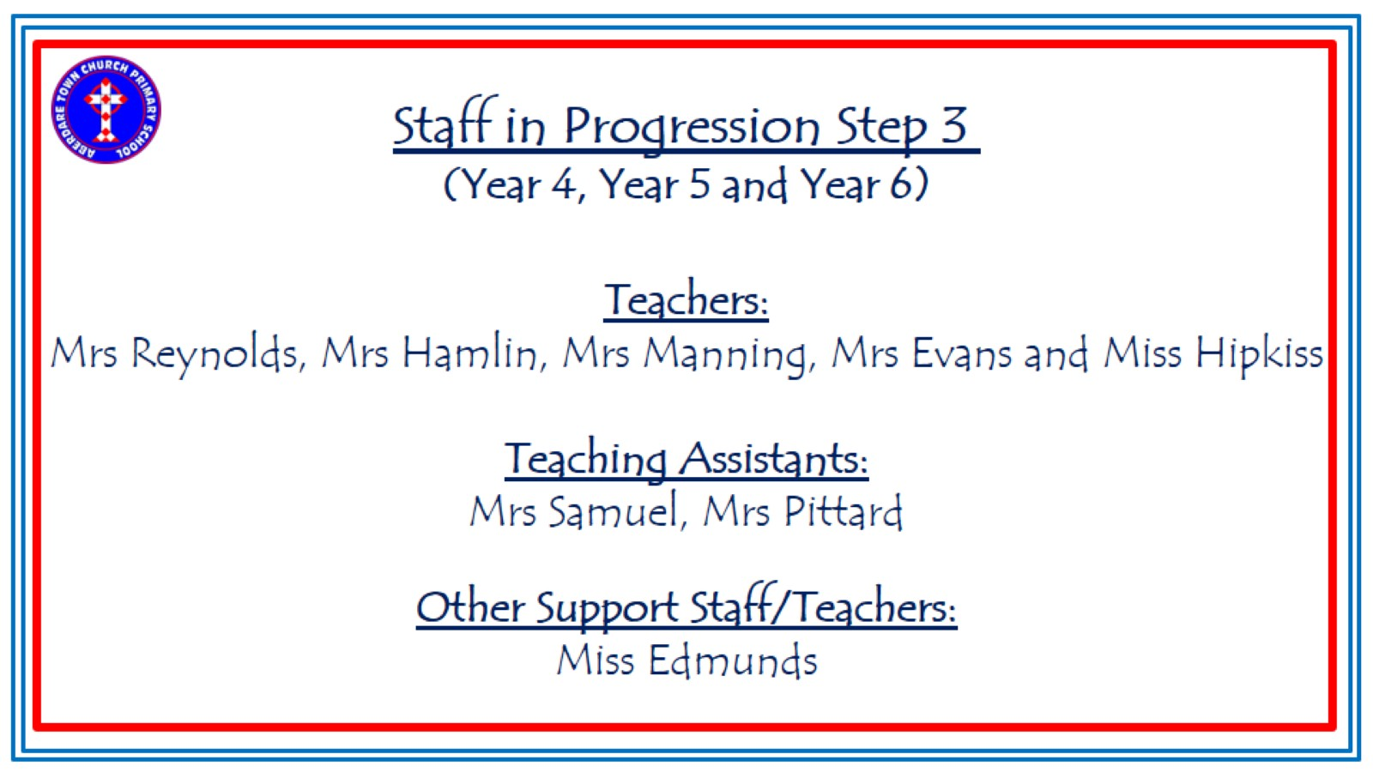
Staff in Progression Step 3
(Year 4, Year 5 and Year 6)
Teachers:
Mrs Reynolds, Mrs Hamlin, Mrs Manning, Mrs Evans and Miss Hipkiss
Teaching Assistants:
Mrs Samuel, Mrs Pittard
Other Support Staff/Teachers:
Miss Edmunds

Slide 3
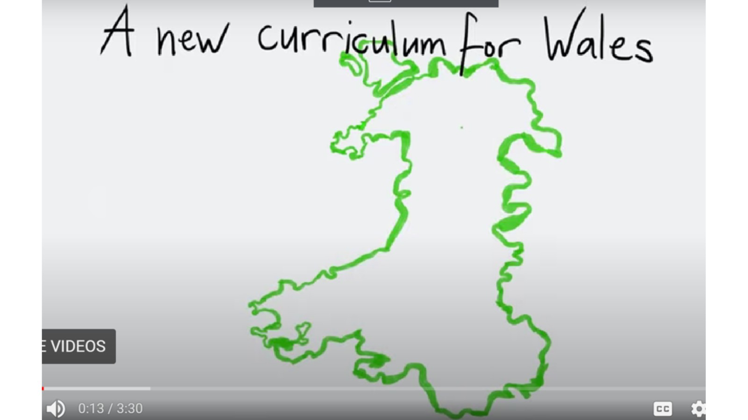

Slide 4


Slide 5


Slide 6
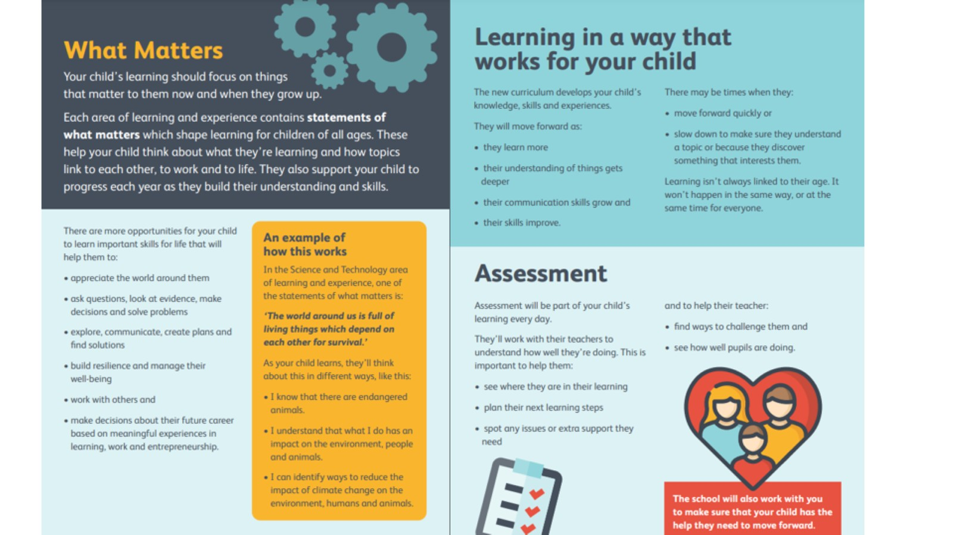

Slide 7


Slide 8


Slide 9
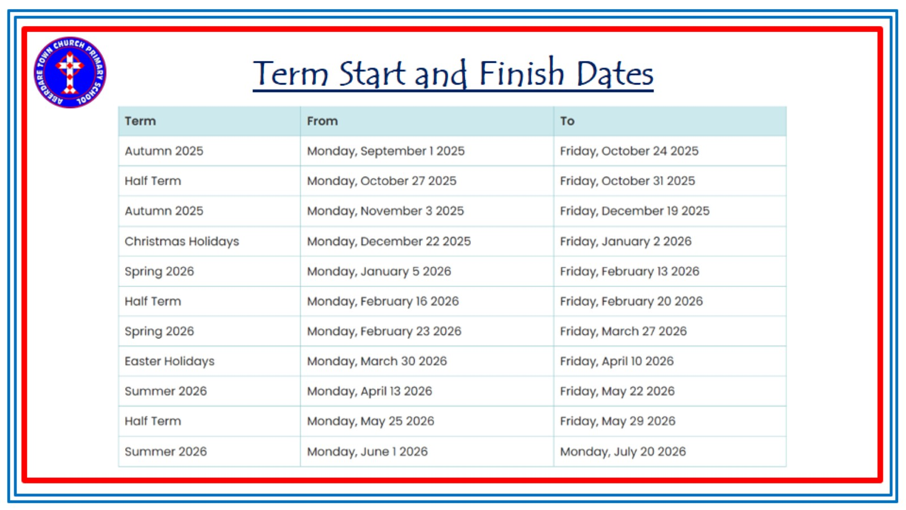

Slide 10
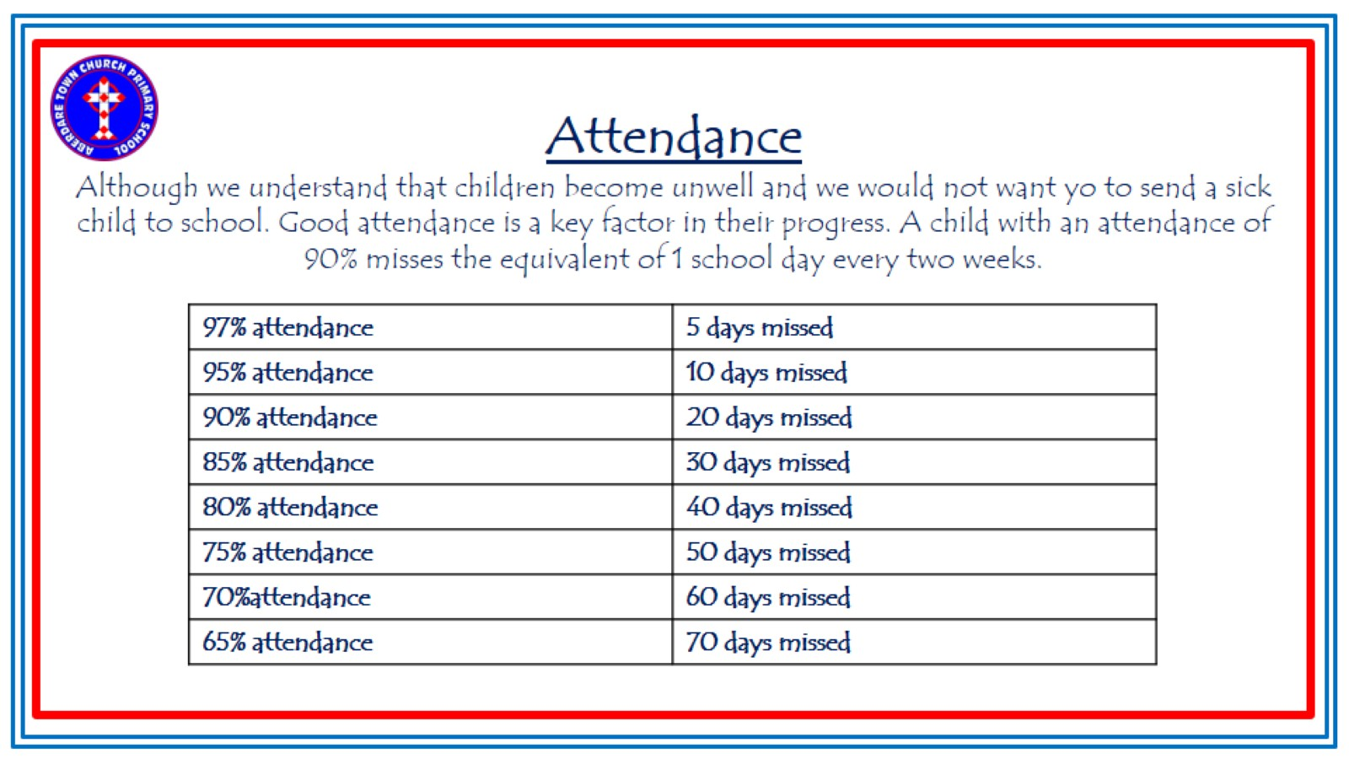

Slide 11
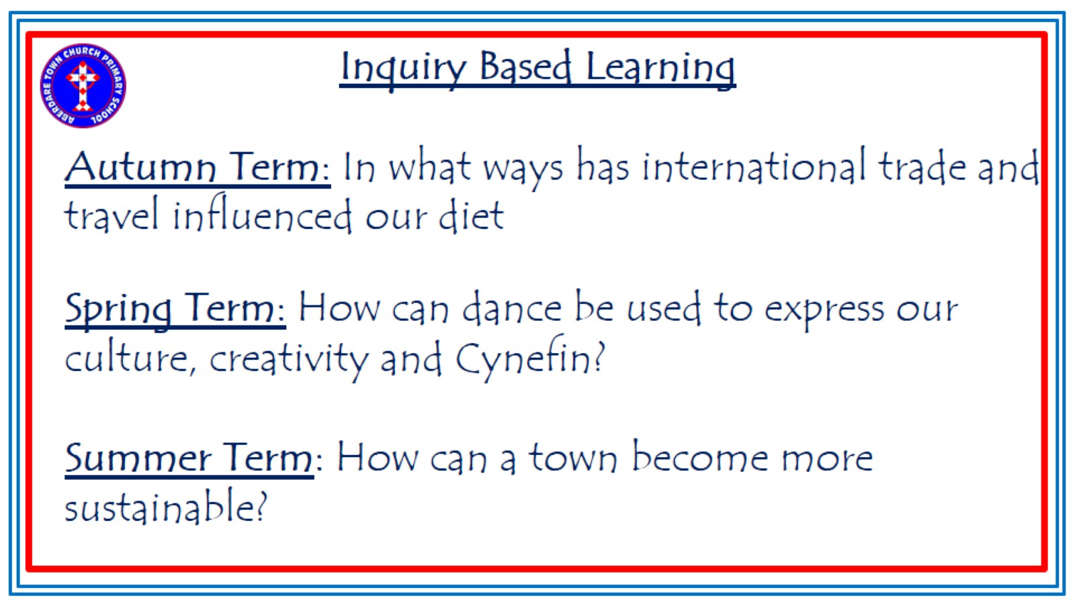
Inquiry Based Learning
Autumn Term: In what ways has international trade and travel influenced our diet
Spring Term: How can dance be used to express our culture, creativity and Cynefin?
Summer Term: How can a town become more sustainable?

Slide 12
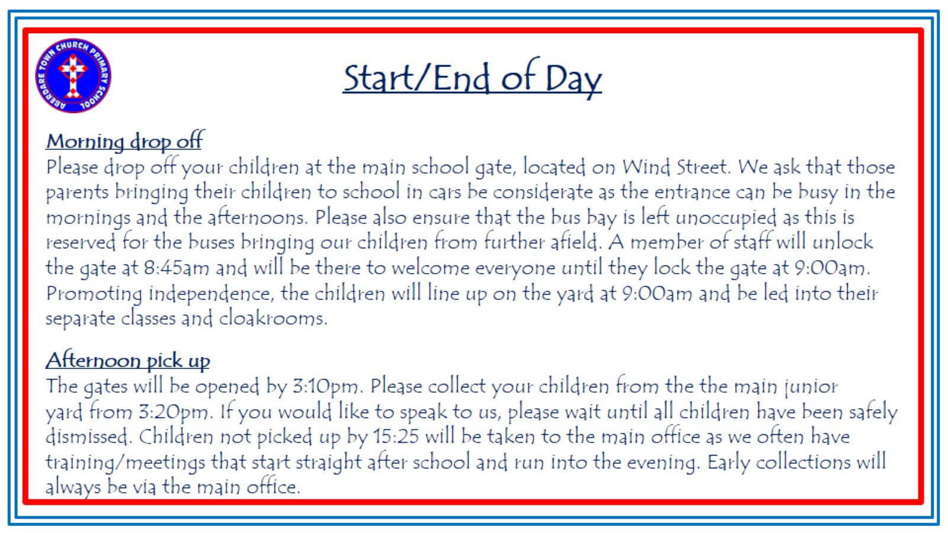
Start/End of Day
Morning drop off
Please drop off your children at the main school gate, located on Wind Street. We ask that those parents bringing their children to school in cars be considerate as the entrance can be busy in the mornings and the afternoons. Please also ensure that the bus bay is left unoccupied as this is reserved for the buses bringing our children from further afield. A member of staff will unlock the gate at 8:45am and will be there to welcome everyone until they lock the gate at 9:00am. Promoting independence, the children will line up on the yard at 9:00am and be led into their separate classes and cloakrooms.
Afternoon pick up
The gates will be opened by 3:10pm. Please collect your children from the the main junior yard from 3:20pm. If you would like to speak to us, please wait until all children have been safely dismissed. Children not picked up by 15:25 will be taken to the main office as we often have training/meetings that start straight after school and run into the evening. Early collections will always be via the main office.

Slide 13
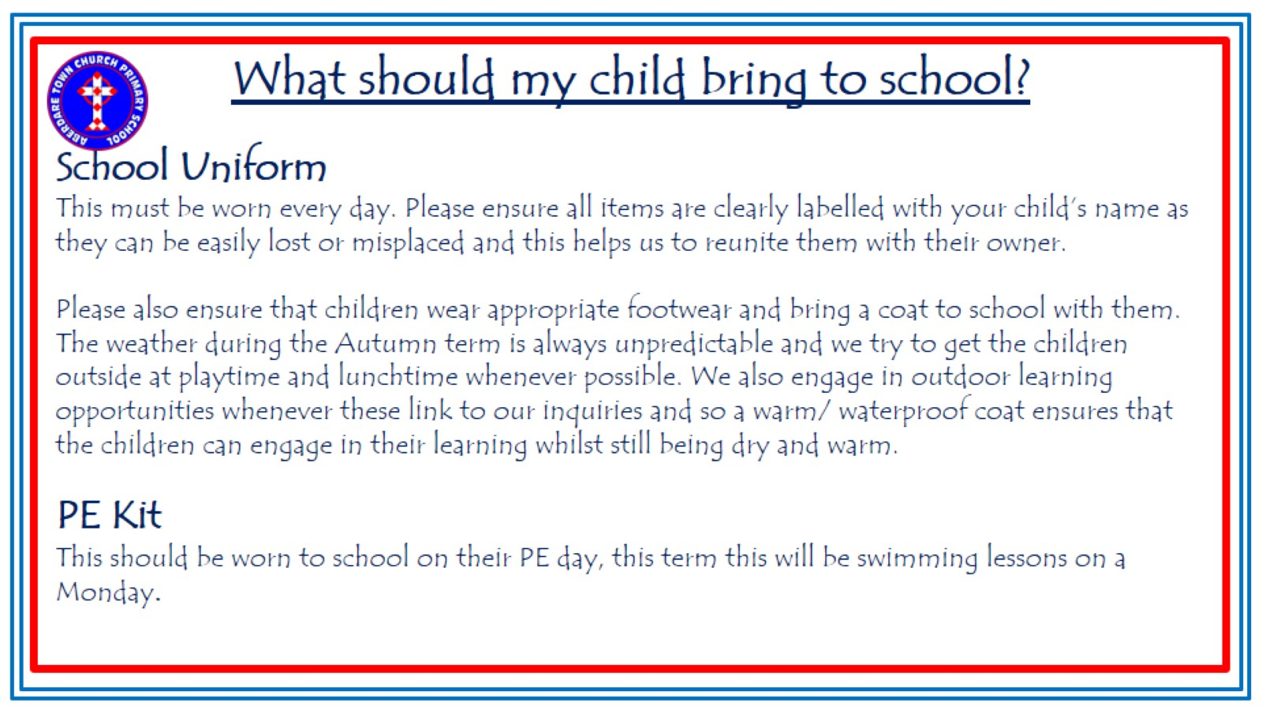
What should my child bring to school?
School Uniform
This must be worn every day. Please ensure all items are clearly labelled with your child’s name as they can be easily lost or misplaced and this helps us to reunite them with their owner.
Please also ensure that children wear appropriate footwear and bring a coat to school with them. The weather during the Autumn term is always unpredictable and we try to get the children outside at playtime and lunchtime whenever possible. We also engage in outdoor learning opportunities whenever these link to our inquiries and so a warm/ waterproof coat ensures that the children can engage in their learning whilst still being dry and warm.
PE Kit
This should be worn to school on their PE day, this term this will be swimming lessons on a Monday.

Slide 14
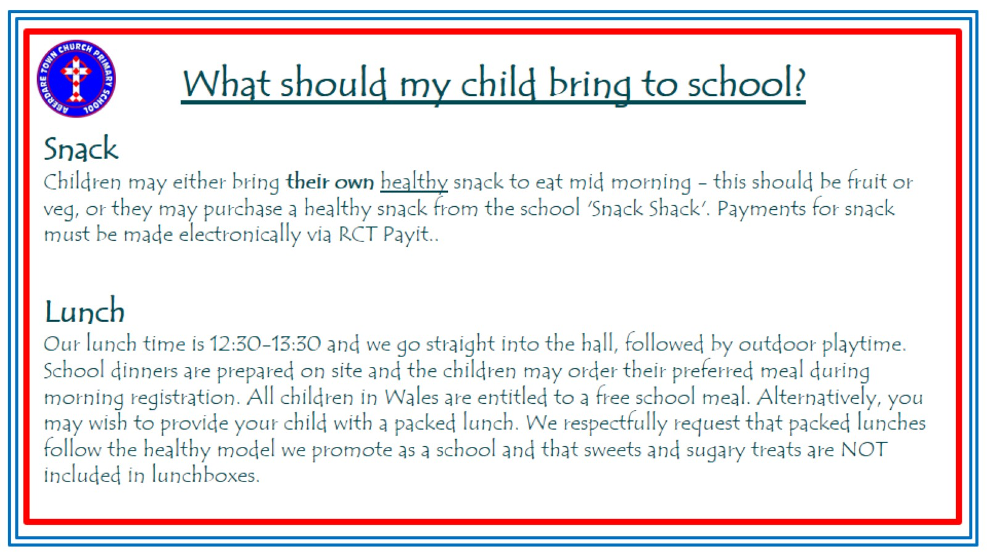
What should my child bring to school?
Snack
Children may either bring their own healthy snack to eat mid morning - this should be fruit or veg, or they may purchase a healthy snack from the school 'Snack Shack'. Payments for snack must be made electronically via RCT Payit..
Lunch
Our lunch time is 12:30-13:30 and we go straight into the hall, followed by outdoor playtime. School dinners are prepared on site and the children may order their preferred meal during morning registration. All children in Wales are entitled to a free school meal. Alternatively, you may wish to provide your child with a packed lunch. We respectfully request that packed lunches follow the healthy model we promote as a school and that sweets and sugary treats are NOT included in lunchboxes.

Slide 15
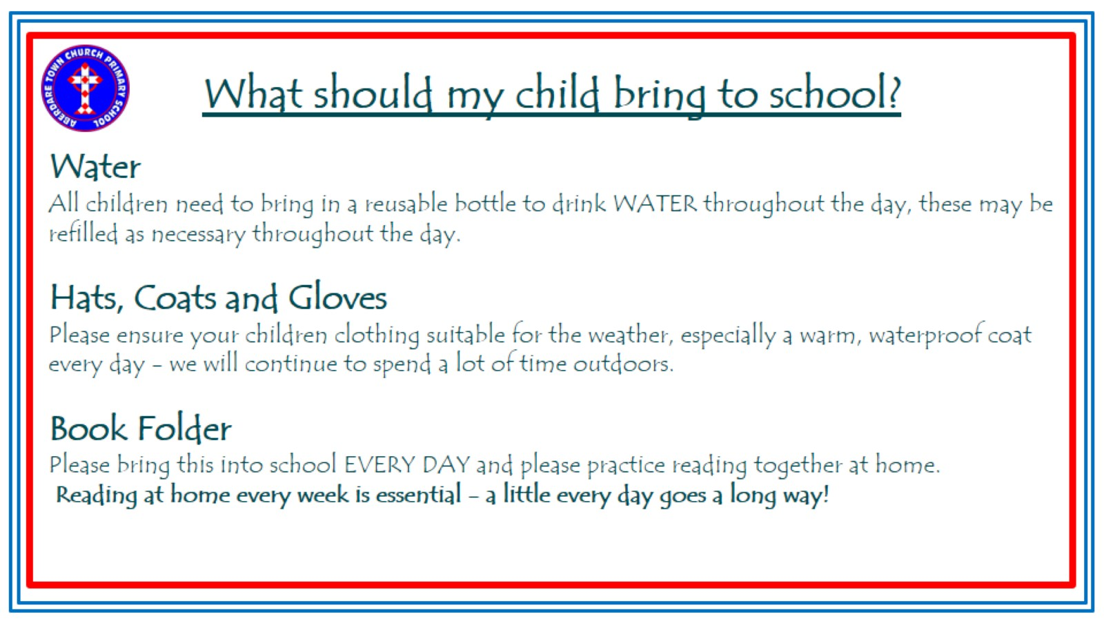
What should my child bring to school?
Water
All children need to bring in a reusable bottle to drink WATER throughout the day, these may be refilled as necessary throughout the day.
Hats, Coats and Gloves
Please ensure your children clothing suitable for the weather, especially a warm, waterproof coat every day - we will continue to spend a lot of time outdoors.
Book Folder
Please bring this into school EVERY DAY and please practice reading together at home.
Reading at home every week is essential - a little every day goes a long way!

Slide 16
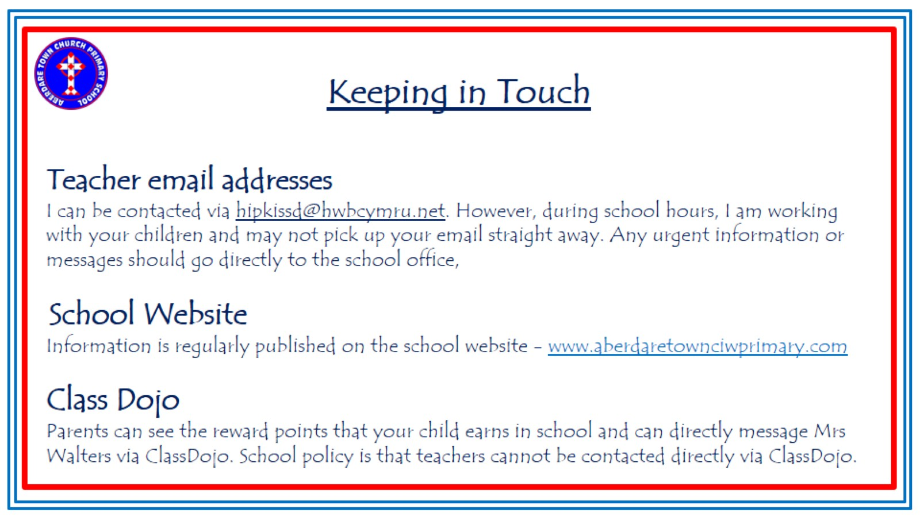
Keeping in Touch
Teacher email addresses
I can be contacted via hipkissd@hwbcymru.net. However, during school hours, I am working with your children and may not pick up your email straight away. Any urgent information or messages should go directly to the school office,
School Website
Information is regularly published on the school website - www.aberdaretownciwprimary.com
Class Dojo
Parents can see the reward points that your child earns in school and can directly message Mrs Walters via ClassDojo. School policy is that teachers cannot be contacted directly via ClassDojo.

Slide 17
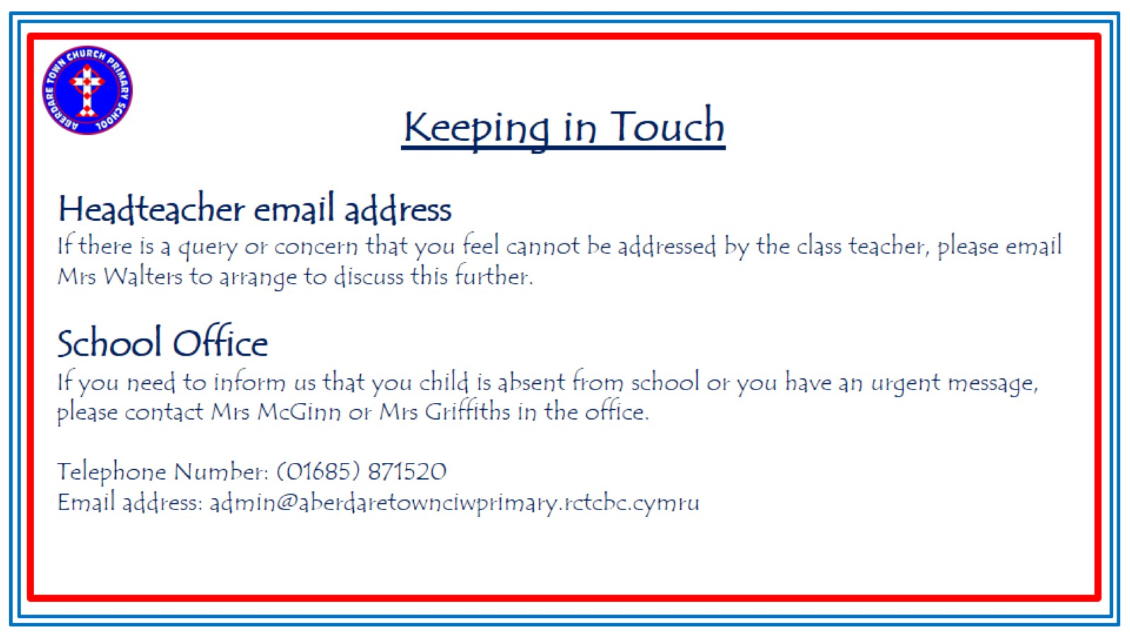
Keeping in Touch
Headteacher email address
If there is a query or concern that you feel cannot be addressed by the class teacher, please email Mrs Walters to arrange to discuss this further.
School Office
If you need to inform us that you child is absent from school or you have an urgent message, please contact Mrs McGinn or Mrs Griffiths in the office.
Telephone Number: (01685) 871520
Email address: admin@aberdaretownciwprimary.rctcbc.cymru

Slide 18
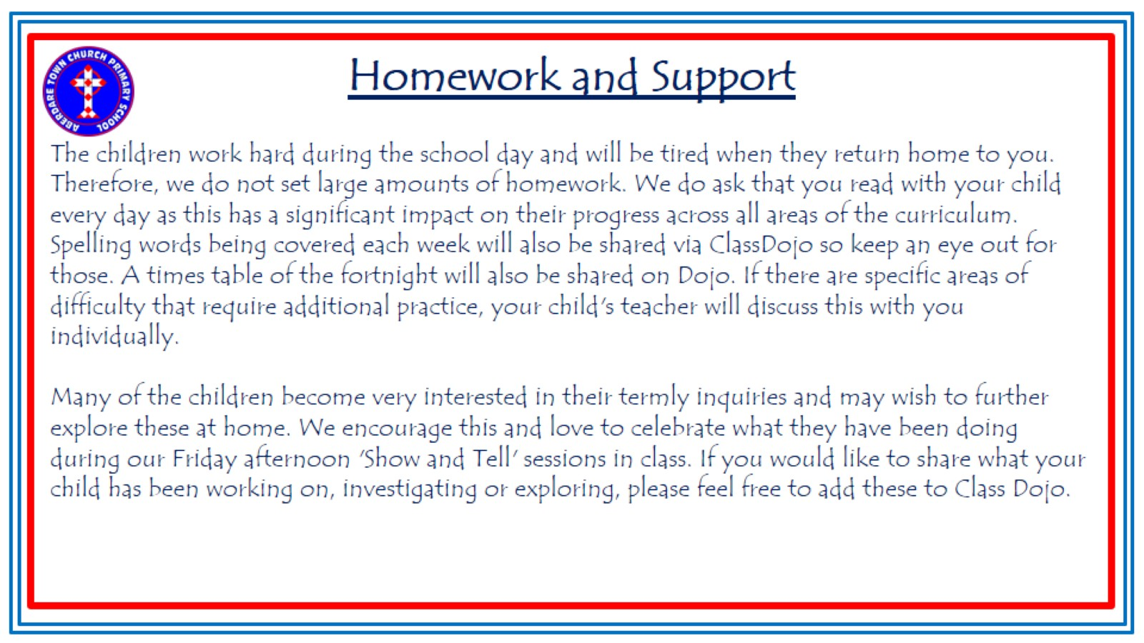
Homework and Support
The children work hard during the school day and will be tired when they return home to you. Therefore, we do not set large amounts of homework. We do ask that you read with your child every day as this has a significant impact on their progress across all areas of the curriculum. Spelling words being covered each week will also be shared via ClassDojo so keep an eye out for those. A times table of the fortnight will also be shared on Dojo. If there are specific areas of difficulty that require additional practice, your child's teacher will discuss this with you individually.
Many of the children become very interested in their termly inquiries and may wish to further explore these at home. We encourage this and love to celebrate what they have been doing during our Friday afternoon 'Show and Tell' sessions in class. If you would like to share what your child has been working on, investigating or exploring, please feel free to add these to Class Dojo.

Slide 19
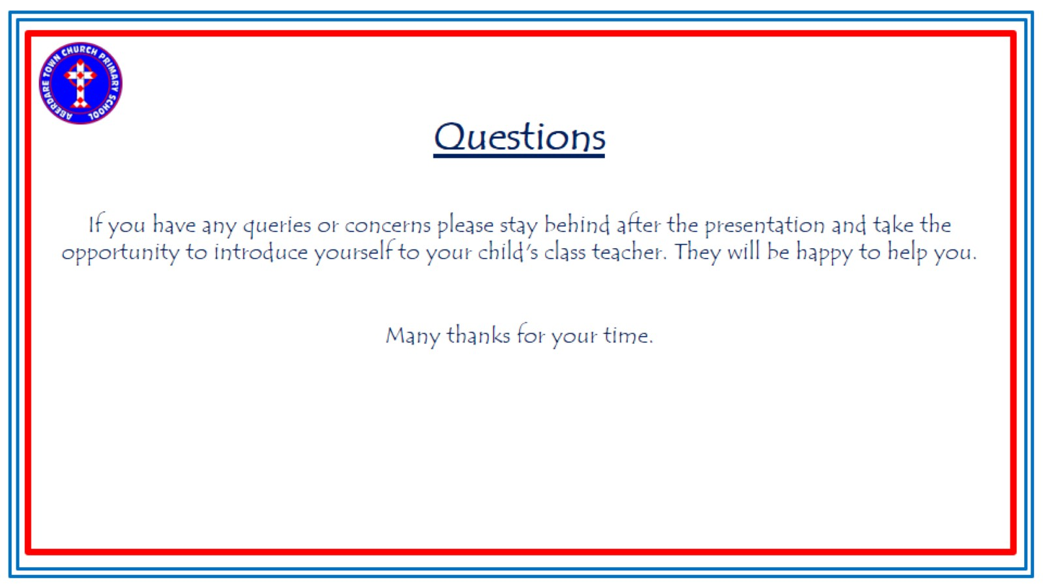
Questions
If you have any queries or concerns please stay behind after the presentation and take the opportunity to introduce yourself to your child's class teacher. They will be happy to help you.
Many thanks for your time.

