Slide 1

Independent Learning in Aberdare Town Church in Wales Primary School: Curriculum for Wales
Promoting self-directed learning, independence in all our pupils.
Notes:
---

Slide 2
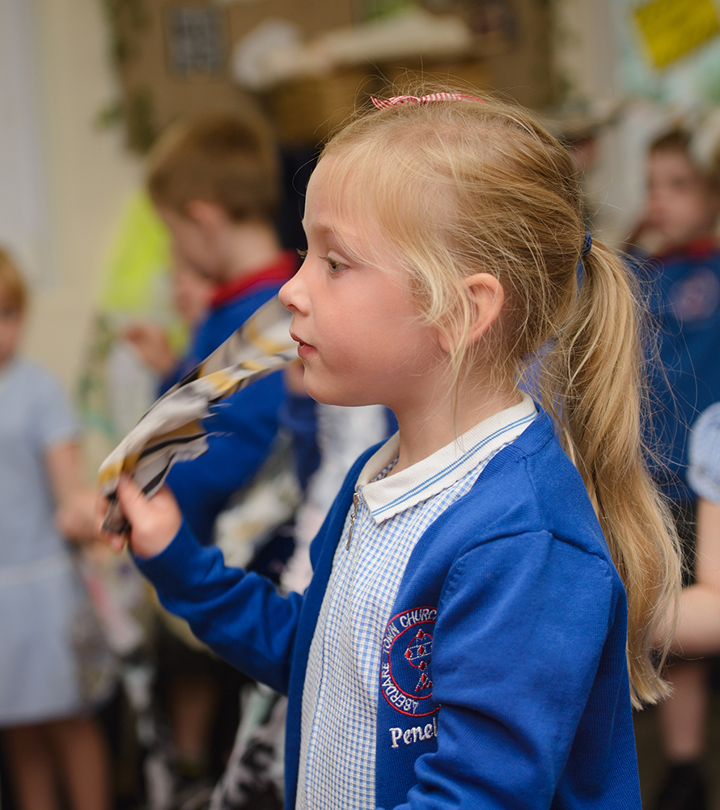
Understanding Independent Learning
Notes:
---
This slide references information from the following file: https://www.abingdon.org.uk/blog/the-importance-of-independent-learning/,https://blog.hope-education.co.uk/a-guide-to-independent-learning-in-the-classroom/
What is Independent Learning?, Why Is It Important?

Slide 3
When you:
Cut it for me
Write it for me,
Open it for me,
Set it up for me,
Draw it for me or find it for me
All I learn is that you do it better than me.

Slide 4
The Big Question
Is tourism a good thing for Cardiff?
How do people survive outdoors?​
Why do National Parks matter?​
What does the Welsh Government do for us?​
In what ways has international trade and travel influenced our diet?
Is conflict avoidable?
When was the best time to be a child?
Who helps us?

Slide 5

What is Independent Learning?
Pupil Ownership
  Independent learning empowers students to take charge of their educational journey by setting their own goals and reflecting on progress.
Self-Motivation and Curiosity
  It encourages students to be self-motivated, curious, and resilient in exploring knowledge independently.
Collaboration and Guidance
  Independent learning includes collaboration with peers and seeking guidance when necessary, not isolation.
Life Skills Development
  Fostering independent learning helps develop decision-making, critical thinking, and adaptability skills in children.
Notes:
---
This slide references information from the following file: https://www.abingdon.org.uk/blog/the-importance-of-independent-learning/,https://blog.hope-education.co.uk/a-guide-to-independent-learning-in-the-classroom/
Independent learning refers to a pedagogical approach where pupils take ownership of their educational journey. It involves students being self-motivated, curious, and resilient in their pursuit of knowledge. Rather than relying solely on teachers or adults, independent learners set their own goals, reflect on their progress, and solve problems autonomously. This approach does not imply isolation; collaboration with peers and seeking guidance when necessary are integral components. In the context of primary education, fostering independent learning helps children develop essential life skills such as decision-making, critical thinking, and adaptability. It encourages them to become active participants in their learning process, which is crucial for their academic and personal development.

Slide 6
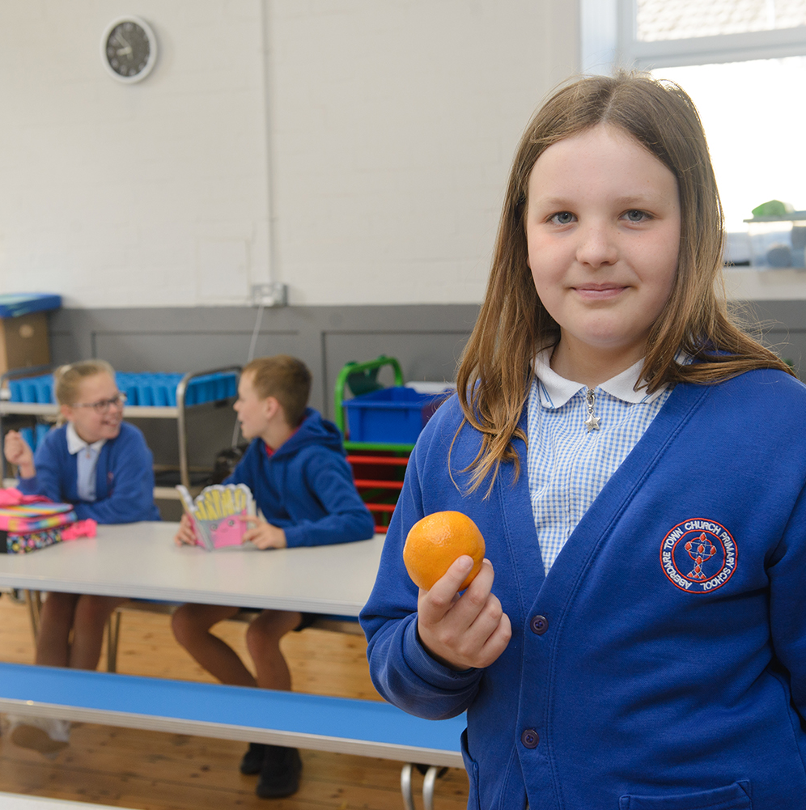

Why Is It Important?
Building Confidence and Motivation
  Independent learning fosters pupil confidence and motivation by encouraging self-directed problem solving and pride in achievements.
Enhancing Critical Thinking
  It nurtures critical thinking and problem-solving skills, preparing students for lifelong learning and future challenges.
Supporting Differentiated Instruction
  Independent learning supports diverse learning needs, allowing teachers to tailor instruction effectively.
Notes:
---
This slide references information from the following file: https://www.abingdon.org.uk/blog/the-importance-of-independent-learning/,https://blog.hope-education.co.uk/a-guide-to-independent-learning-in-the-classroom/
Independent learning is vital in primary education as it builds confidence and self-esteem among pupils. It nurtures critical thinking and problem-solving abilities, preparing children for lifelong learning and future challenges. By engaging in independent learning, students become more motivated and invested in their education. They learn to identify their own knowledge gaps and take pride in finding solutions, which enhances their overall learning experience. This approach aligns with the goals of the Curriculum for Wales, which emphasizes the development of ambitious, capable learners who are ready to thrive in a rapidly changing world. Independent learning also supports differentiated instruction, allowing teachers to cater to diverse learning needs effectively.

Slide 7
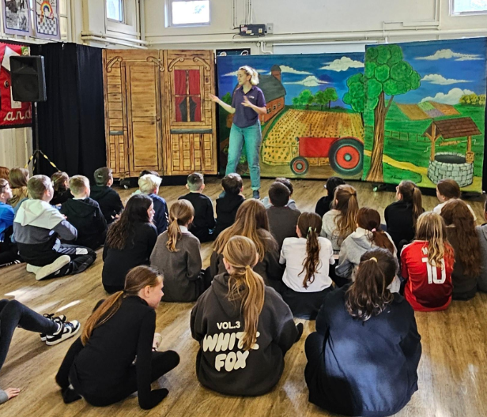
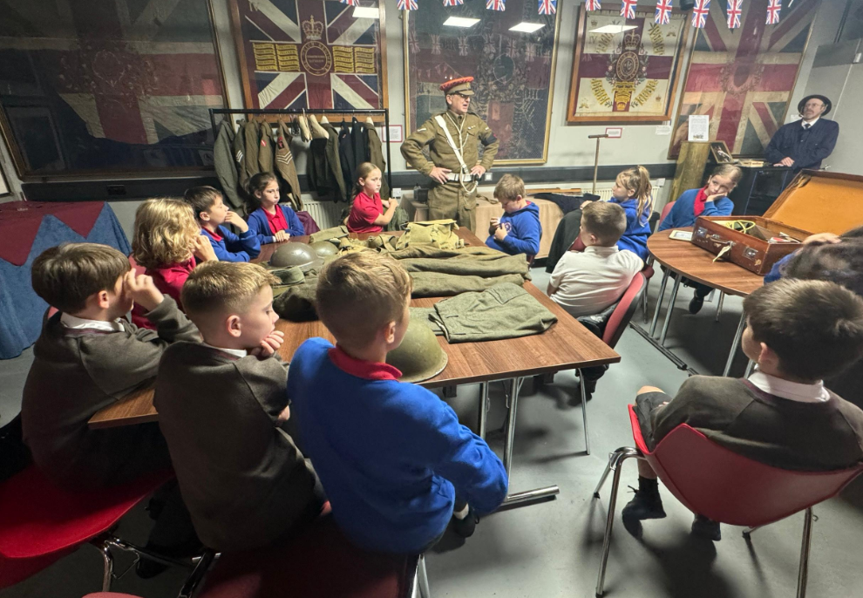
School Strategies for Independent Learning
Inquiry
Notes:
---
This slide references information from the following file: https://estyn.gov.wales/improvement-resources/striving-for-independent-learning-for-all-pupils/,https://nael.cymru/en/case-studies/learner-self-reflection-on-independent-learning/,https://estyn.gov.wales/improvement-resources/enabling-pupils-to-become-independent-learners/
Promoting Independence in the Classroom, Benefits for Pupils

Slide 8
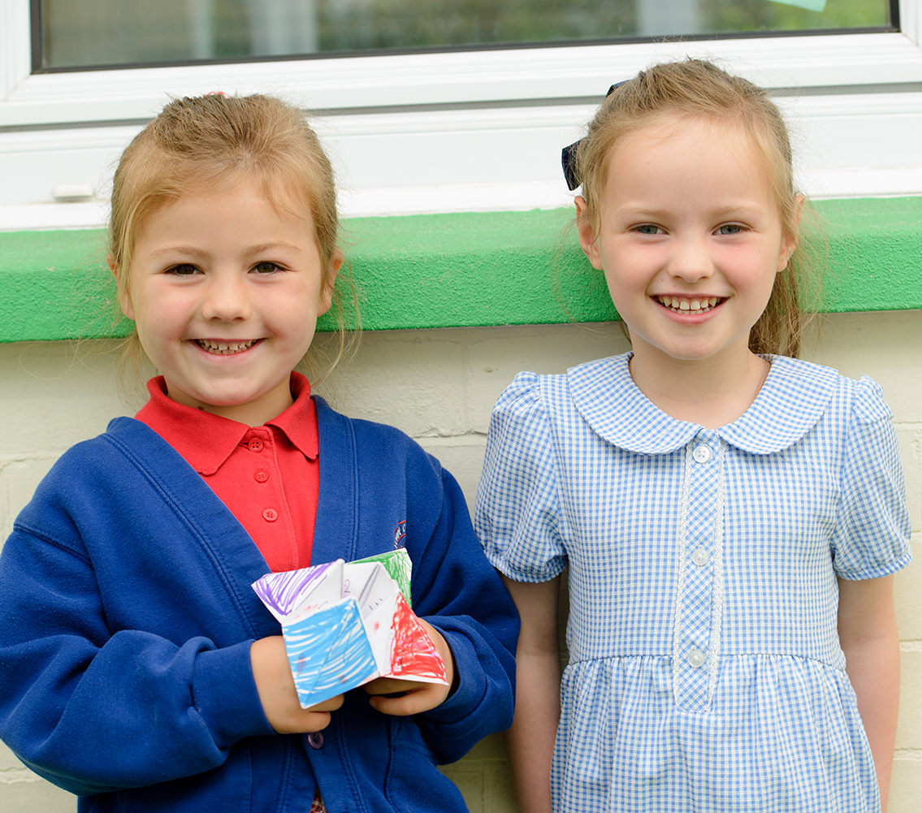
Promoting Independence in the Classroom
Pupil-Led
  Students help to lead the learning, choosing areas they are interested in and guiding their own learning process.
Assessment for Learning
  Assessment strategies help staff and pupils evaluate progress and set goals to enhance independent learning.
Child-Centred ALN Planning
  Personalised support through child-centred planning ensures learners with Additional Learning Needs thrive independently.
Use of Digital Tools
  Digital platforms like J2E on Hwb and SEESAW enable pupils to record reflections and track their learning journey.
Notes:
---
This slide references information from the following file: https://estyn.gov.wales/improvement-resources/striving-for-independent-learning-for-all-pupils/,https://nael.cymru/en/case-studies/learner-self-reflection-on-independent-learning/,https://estyn.gov.wales/improvement-resources/enabling-pupils-to-become-independent-learners/
Schools in Wales employ various strategies to promote independent learning among primary pupils. These include pupil-led thematic planning, such as 'Pioneer Weeks', where students choose topics and guide the learning process. Assessment for learning strategies are used to help pupils evaluate their progress and set future goals. Child-centred planning for Additional Learning Needs (ALN) ensures that all learners receive personalized support. Digital tools like J2E on Hwb enable students to record their reflections and track their learning journey. Encouraging pupil voice in curriculum design fosters engagement and ownership. These strategies collectively create a learning environment where independence is nurtured and valued.

Slide 9
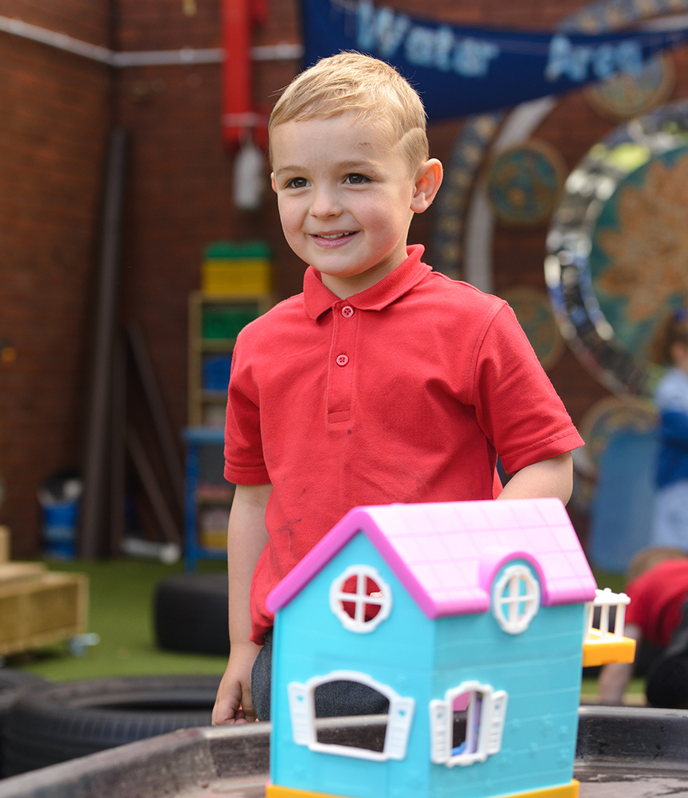
Benefits for Pupils
Improved Academic Performance
  Independent learning encourages active engagement and helps pupils develop deeper understanding of subjects.
Enhanced Motivation and Confidence
  Pupils gain motivation and confidence by taking pride in their own achievements through self-directed learning.
Development of Organisational Skills
  Self-directed tasks help pupils build organisational and creative thinking skills crucial for success.
  Social Inclusion and Belonging
  Independent learning fosters social inclusion by promoting a sense of belonging and reducing alienation.
Notes:
---
This slide references information from the following file: https://estyn.gov.wales/improvement-resources/striving-for-independent-learning-for-all-pupils/,https://nael.cymru/en/case-studies/learner-self-reflection-on-independent-learning/,https://estyn.gov.wales/improvement-resources/enabling-pupils-to-become-independent-learners/
Independent learning offers numerous benefits for primary school pupils. It enhances academic performance by encouraging active engagement and deeper understanding. Motivation and confidence increase as students take pride in their achievements. Organizational skills and creative thinking are developed through self-directed tasks. Pupils become more aware of their strengths and limitations, enabling them to manage their learning effectively. Social inclusion is also promoted, as independent learning fosters a sense of belonging and reduces alienation. These benefits contribute to the overall development of pupils, preparing them for future educational and life challenges.

Slide 10
Parental Involvement and School Commitment
Notes:
How Parents Can Support, School Commitment to Independence

Slide 11

How Parents Can Support
Encouraging Curiosity
  Parents can encourage children to ask questions to foster a love for learning and curiosity.
Supporting Goal-Setting
  Helping children set goals and reflect on progress builds responsibility and independent learning skills.
Celebrating Effort
  Celebrating effort and improvement fosters resilience and motivates children beyond just outcomes.
Home-School Partnership
  Engaging with school activities and providing feedback strengthens collaboration between home and school.
Notes:
Parents play a crucial role in supporting independent learning at home. Encouraging curiosity and asking questions helps children develop a love for learning. Supporting goal-setting and reflection enables pupils to take responsibility for their progress. Celebrating effort and improvement, rather than just outcomes, fosters resilience and motivation. Engaging with school activities and providing feedback strengthens the home-school partnership. By creating a supportive environment, parents can reinforce the principles of independent learning and contribute to their child's educational success.

Slide 12
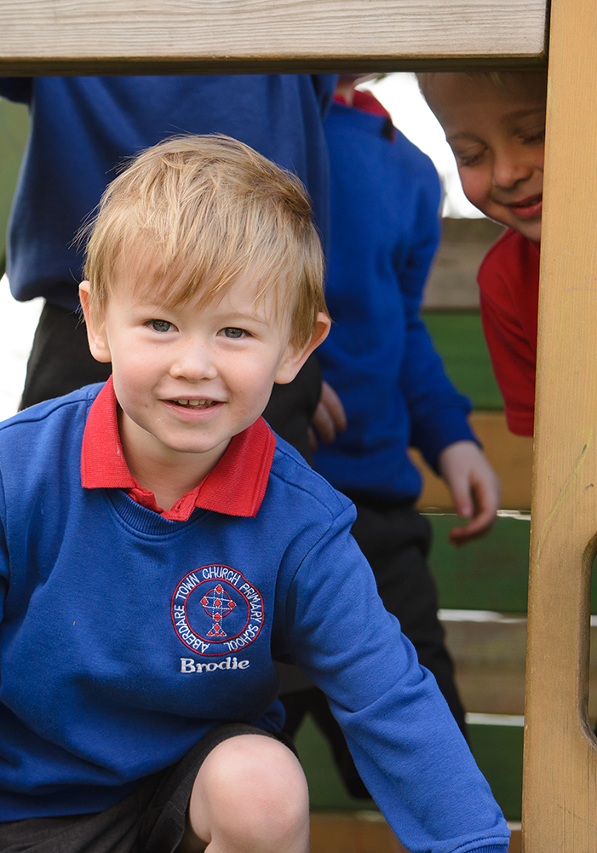
School Commitment to Independence
Promoting Independent Learning
  The school emphasizes fostering independence in students starting from the Foundation Phase.
Utilising Community Resources
  Community resources are integrated to enrich and support diverse educational experiences.
Adaptive Teaching Methods
  Teaching methods are continuously adapted to meet the varying needs of pupils effectively.
Lifelong Learning Skills
  Embedding independence equips learners with essential skills and mindsets for lifelong learning.
Notes:
Aberdare Town CiW Primary School is committed to fostering independent learning from the Foundation Phase onward. The school utilizes community resources to enrich educational experiences and continuously adapts teaching methods to meet the diverse needs of pupils. By embedding independence into the curriculum and daily practices, the school ensures that learners are equipped with the skills and mindset necessary for lifelong learning. This commitment reflects the broader goals of the Curriculum for Wales and demonstrates the school's dedication to pupil development.

Slide 13
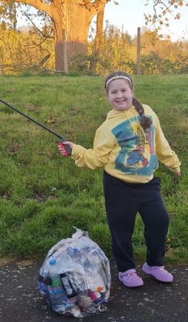
The Four Purposes of the Curriculum
Ambitious, Capable Learners
  The curriculum encourages independent learning to foster ambition and capability in students.
Enterprising, Creative Contributors
  Self-directed projects and thematic learning nurture creativity and enterprise among pupils.
Ethical, Informed Citizens
  Students explore diverse perspectives to develop ethical awareness and make informed decisions.
Healthy, Confident Individuals
  Pupils gain confidence and wellbeing through autonomy and recognising their educational influence.
Notes:
---
This slide references information from the following file: https://www.goodschoolsguide.co.uk/uk-schools/advice/welsh-schools-and-the-curriculum-for-wales,https://hwb.gov.wales/curriculum-for-wales
The Curriculum for Wales is built around four key purposes aimed at developing well-rounded individuals. These purposes are: ambitious, capable learners; enterprising, creative contributors; ethical, informed citizens; and healthy, confident individuals. Independent learning is central to achieving these goals. By encouraging pupils to take charge of their learning, the curriculum fosters ambition and capability. Creative contributions are nurtured through self-directed projects and thematic learning. Ethical citizenship is promoted by allowing students to explore diverse perspectives and make informed decisions. Confidence and well-being are enhanced as pupils gain autonomy and recognize their ability to influence their educational outcomes. These purposes guide all learning experiences and are embedded across all areas of the curriculum.

Slide 14

Welsh Government Guidance
Core Learning Principles
  Play-based learning, authentic experiences, and effective environments form the foundation of independent learning in Wales.
Personalised Progression
  Curriculum ensures progression and personalised learning tailored to each pupil’s developmental needs.
Enabling Independence
  Engaging experiences, enabling adults, and supportive environments foster learner independence effectively.
Holistic and Digital Integration
  Holistic learning and digital tools support self-reflection and goal setting to empower learners.
Notes:
---
This slide references information from the following file: https://www.goodschoolsguide.co.uk/uk-schools/advice/welsh-schools-and-the-curriculum-for-wales,https://hwb.gov.wales/curriculum-for-wales
The Welsh Government provides comprehensive guidance on implementing independent learning within the Curriculum for Wales. Key principles include play-based learning, authentic experiences, and effective learning environments. The framework emphasizes progression and personalized learning, ensuring that each pupil's developmental needs are met. Enablers such as engaging experiences, enabling adults, and supportive environments are crucial for fostering independence. The guidance also outlines the importance of holistic learning and the integration of digital tools to support self-reflection and goal setting. By adhering to these principles, schools can create a curriculum that empowers learners and aligns with national educational objectives.

Slide 15
When you:
Cut it for me
Write it for me,
Open it for me,
Set it up for me,
Draw it for me or find it for me
All I learn is that you do it better than me.

