Slide 1
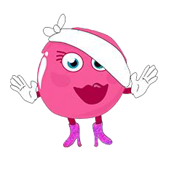










Monster Phonics at
Aberdare Town Church in Wales Primary School

Slide 2



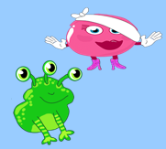
Why is learning to read so tricky?
English has 44 sounds but only 26 letters.
The same sound can be written in many different ways:
rain, day, cake, they and great → all make the long ai sound.
The same letters can make different sounds:
cow vs snow (both use “ow” but sound different).
Many words are not spelled the way they sound (was, said, one, people).
Children need to learn to decode words step by step rather than guess, which limits their progress.
A systematic phonics scheme like Monster Phonics gives children clear strategies to untangle these complexities and become confident readers.

Slide 3




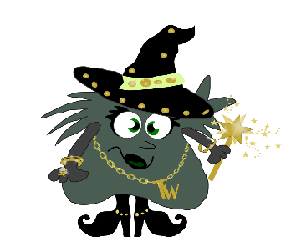
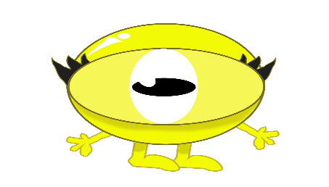
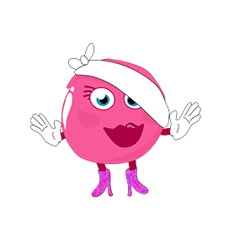

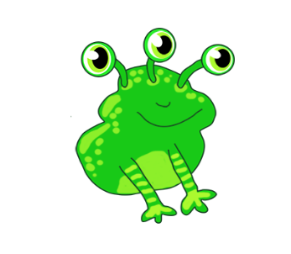

The Monster Phonics Approach
Monster Phonics is a phonic scheme which we have recently introduced at Aberdare Town Church Primary School. It is based on the Letters and Sounds document and has a whole class approach. It is primarily used in Foundation Learning, but can also be used as an intervention in Progression Step 3.
Monster Phonics is a multi-sensory approach to learning phonics.
It is engaging and each set of phonemes are colour coded.
Ten monsters are linked to a colour. This makes it easier for the children to learn and recall their sounds and tricky words.
Each monster has a backstory.
It engages the children by using all their senses. Lessons involve videos, action songs, games, story telling, use of magnetic letters, drawing, writing.
It makes phonics memorable and fun!

Slide 4
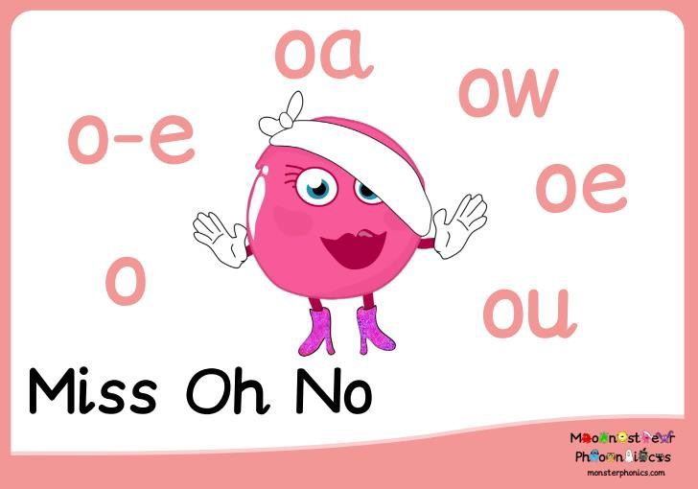
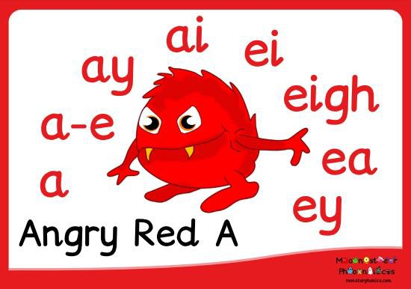
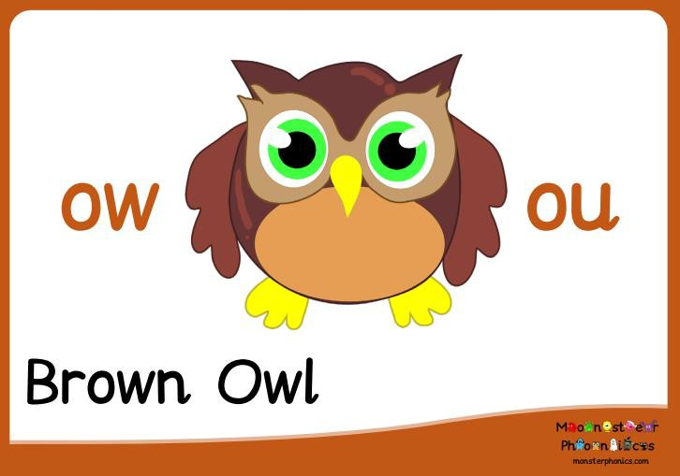



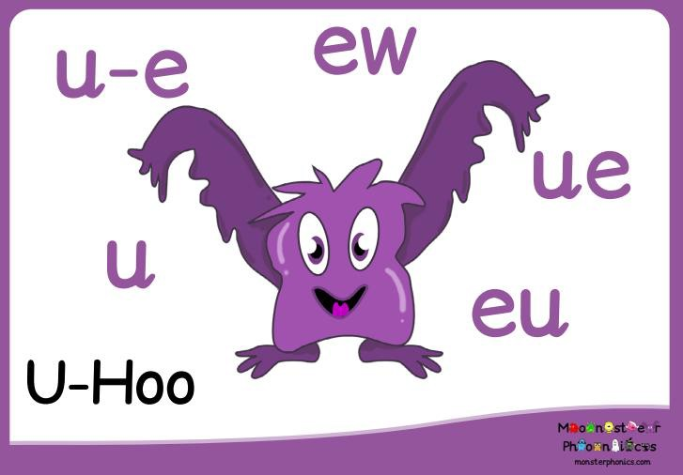
Each monster has one colour, one sound, and has many ways of representing that sound.

Slide 5
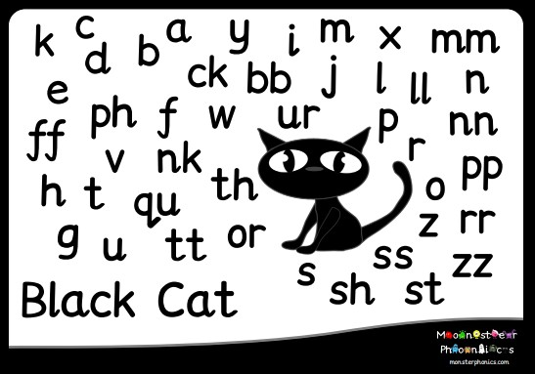
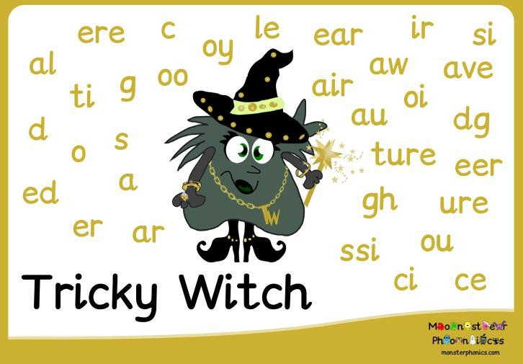
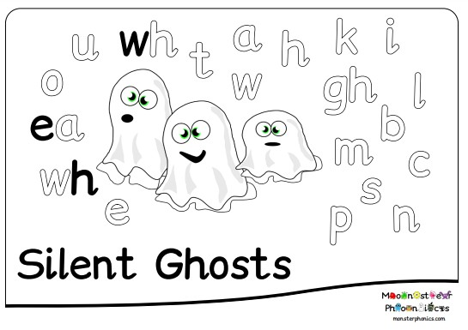

Slide 6
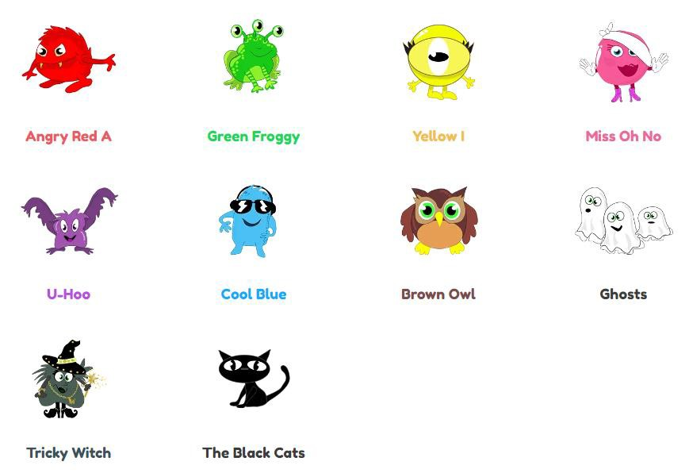

Meet the Monsters…
Click here to meet the monsters!

Slide 7
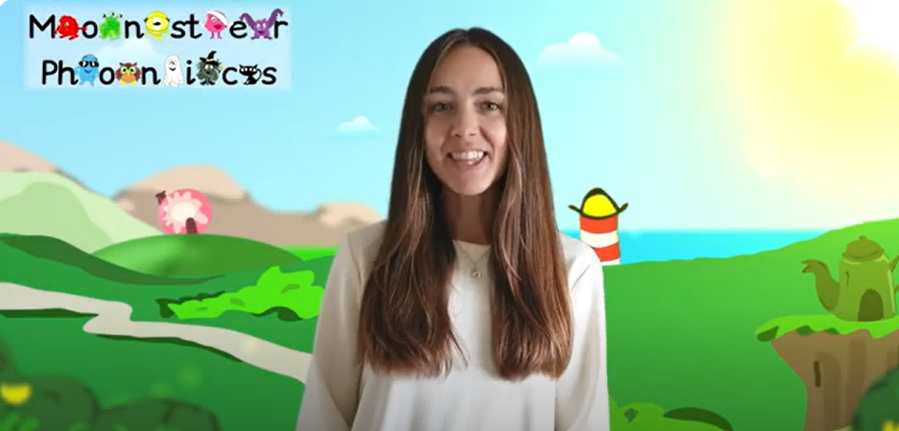

Each monster has an action…

Slide 8
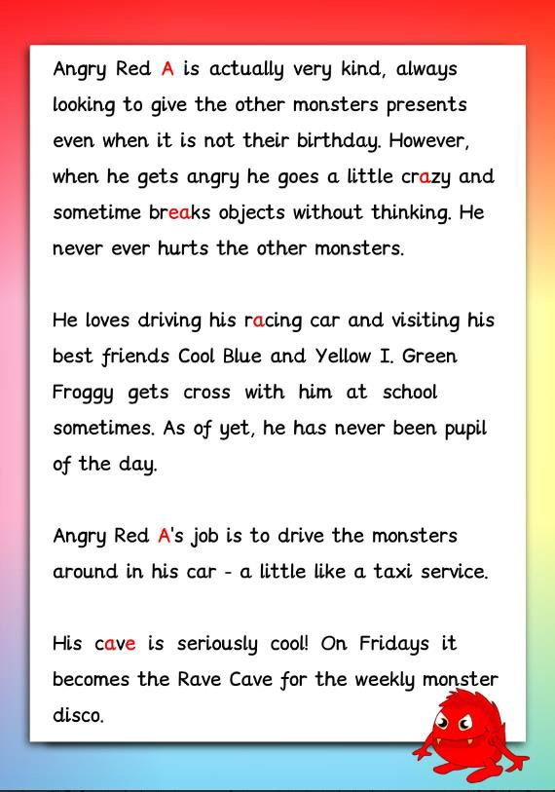
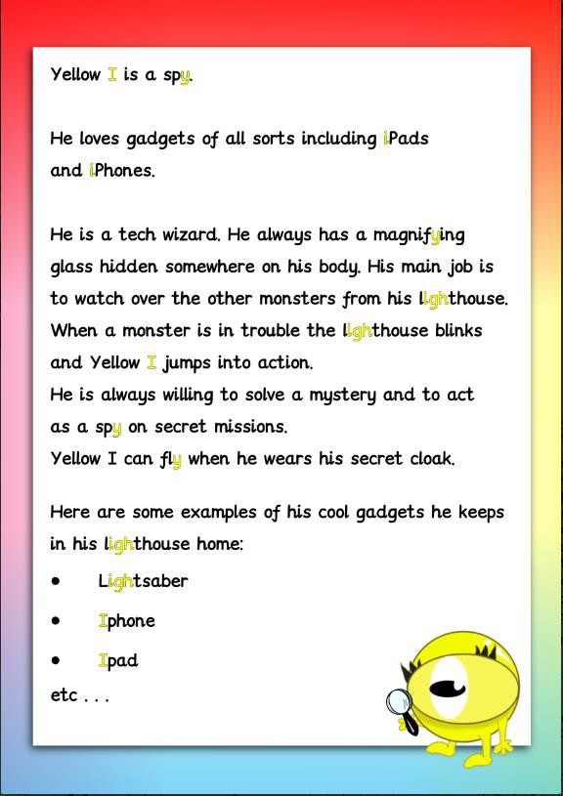
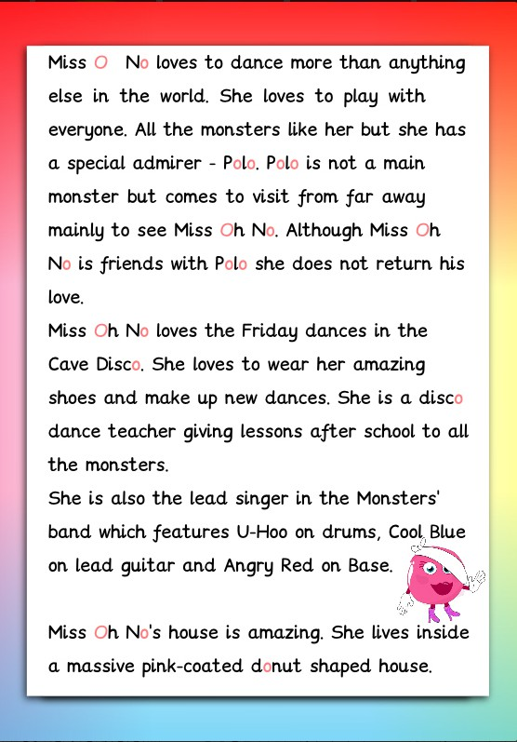
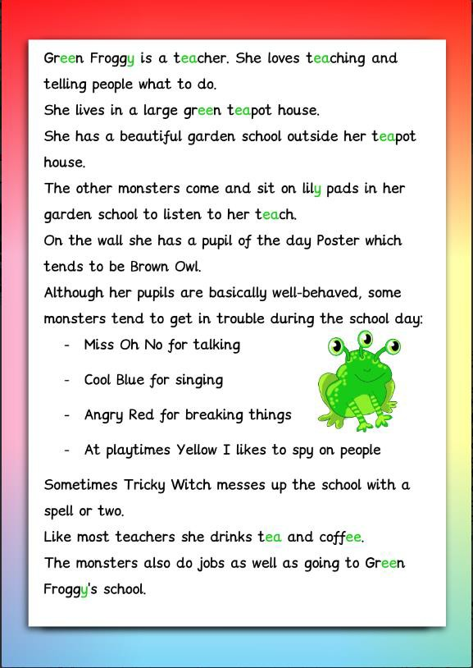
Each monster
has a backstory…

Slide 9
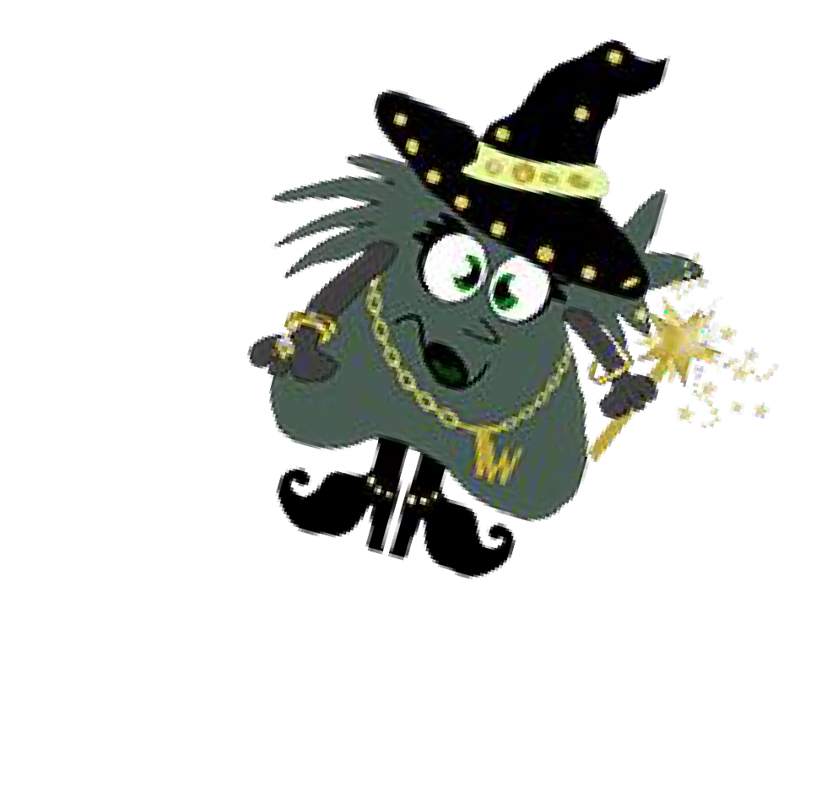
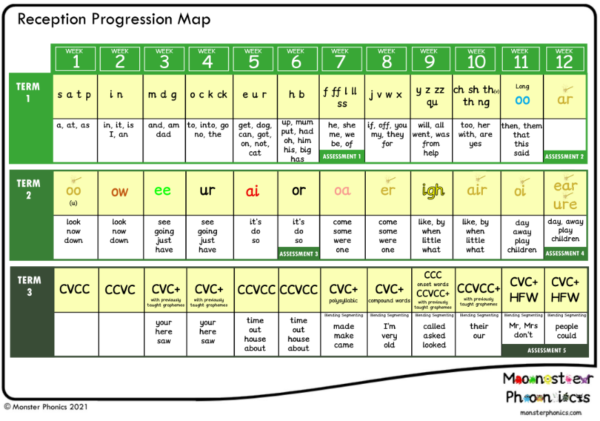
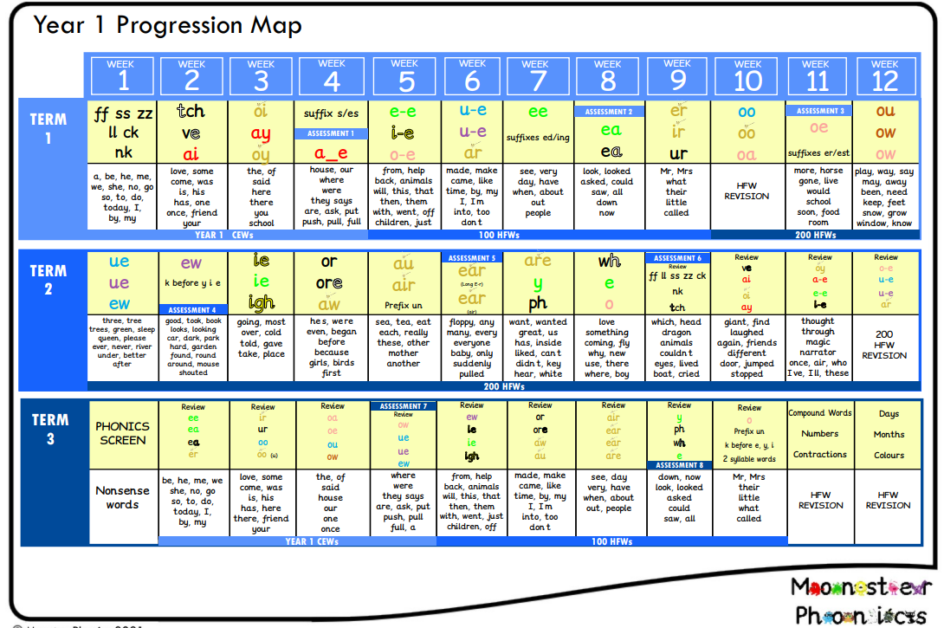
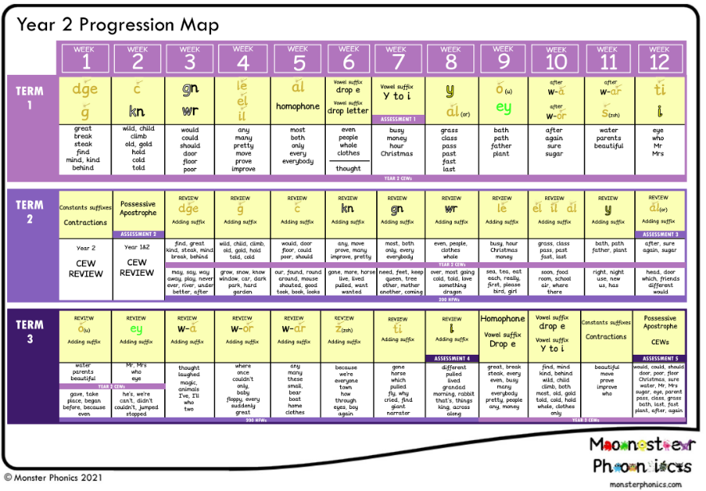
How is Monster Phonics being taught at Town Church?
The Monster Phonics progression maps ensure that we teach our children sounds, words and skills in a particular order.
We start with single letter sounds to enable children to read and spell simple words, leading to consonant digraphs and vowel digraphs ( 2 and 3 letter units) and longer words.
Common exception words are also taught in a progression that fits within the phonics programme.

Slide 10

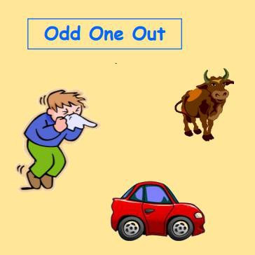
How is Monster Phonics being taught at Town Church?
Begins in nursery.
Develops speaking and listening skills.
Focuses on environmental sounds, listening and tuning into sounds they hear around them.
Prepares children for learning to read with phonics.
Phase 1
Parents can play a vital role in helping their children develop these skills, by encouraging their children to listen carefully and talk extensively about what they hear, see and do.

Slide 11

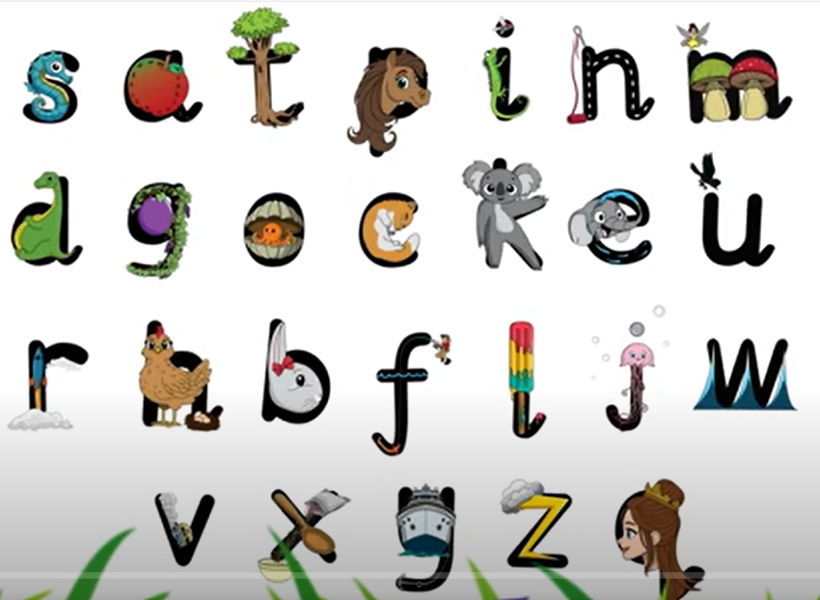
Focuses on learning the first sounds (black cat sounds) and some tricky words.
Children are taught how to make ‘pure sounds’.
Blending and segmenting are taught.
Children are taught to write the letters as they learn them using letter formation rhymes.
Phase 2

Slide 12
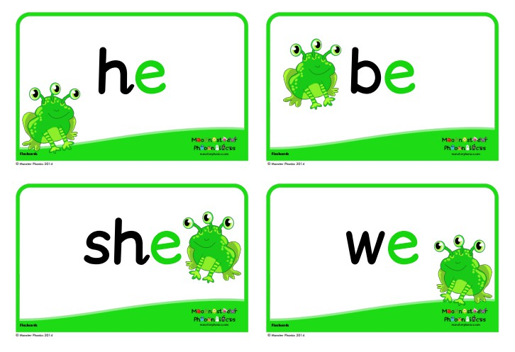
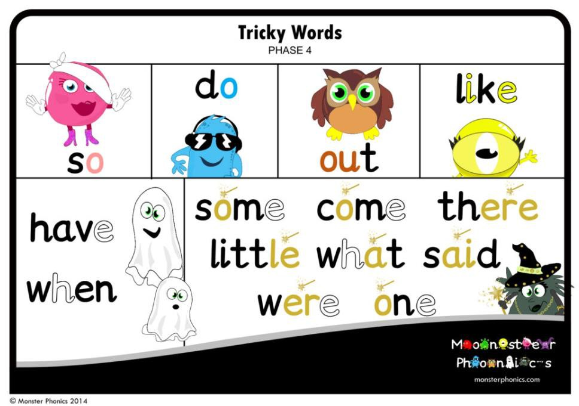
Phase 3
Introduces digraphs, trigraphs and more tricky words.
Children consolidate learning by manipulating phonemes and graphemes they have already learnt.
Children are taught to blend and segment longer words with
adjacent consonants.
Phase 4

Slide 13
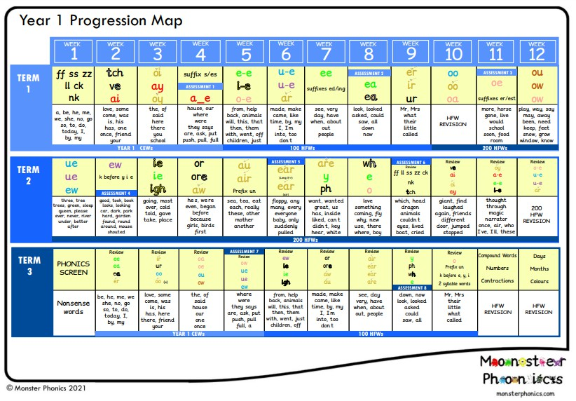

Introduces graphemes that have more than one sound.
Introduces more tricky words.
Phase 5
Children apply their
phonic skills and knowledge to recognise and spell more complex words.
They read an increasing number of high and medium frequency words independently and automatically.
Phase 6

Slide 14
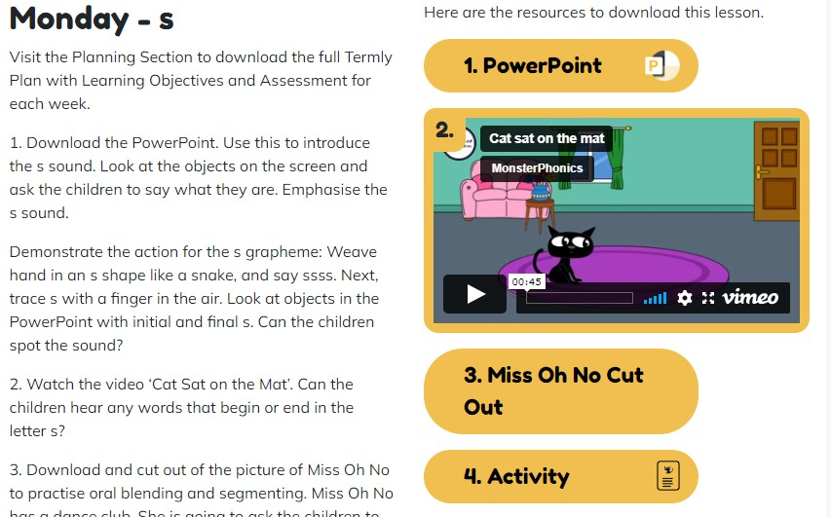
What does a typical phonics lesson look like?
Children have daily 30 minute phonic sessions.
Sessions are split into four sections:
Revisit & review the previous sound and word building.
Teach a new phonic sound.
Practise the new sound.
Apply in different situations, e.g. Reading in a sentence or writing the word in a sentence.
Each lesson is planned with the use of visual, auditory and physical movements to help the children learn new phonic skills.

Slide 15
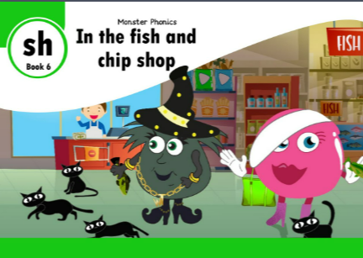

Monster Phonics
eBooks
You will soon receive an invitation to access the Monster Phonics eBooks at home, along with a username and password. You will be able to explore the full online library, with a wide choice of fiction, non-fiction, comics and more. The books are organised into reading stages, and you can help your child choose the level that is right for them. Please continue to use your child’s reading record to share any comments about their progress.
https://ebooks.monsterphonics.com/

Slide 16
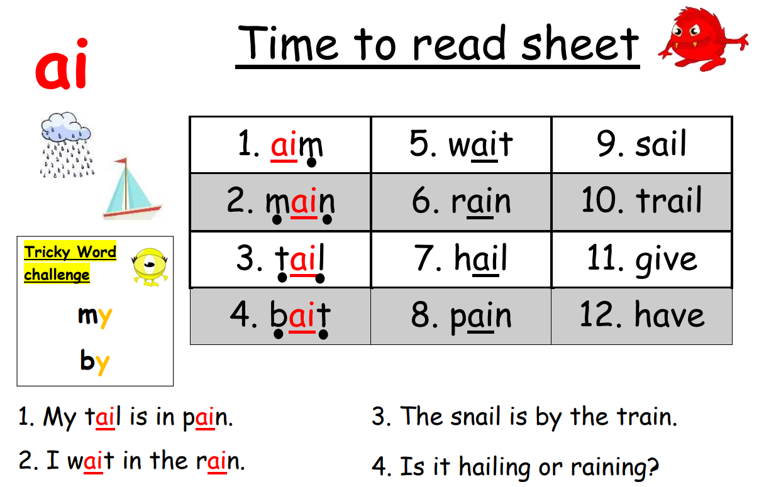

Slide 17
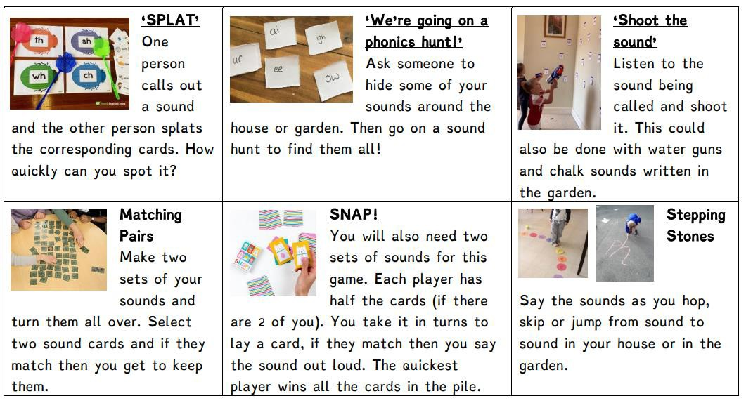
What else can you do at home to support your child’s reading?

Slide 18

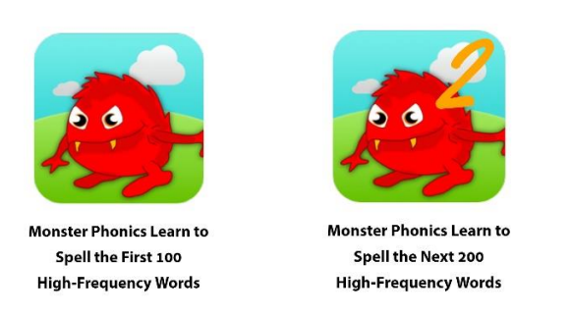
Links to support phonics at home
Information Sites
https://monsterphonics.com/phonics-support-for-parents/
https://monsterphonics.com/how-it-works/
https://monsterphonics.com/free-phonics-worksheets/
https://www.aberdaretownciwprimary.co.uk/page/?title=Monster+Phonics&pid=46
Monster Phonics actions https://www.youtube.com/watch?v=RwLyFPIcTig
Free Online Games
https://www.phonicsplay.co.uk/resources
https://www.phonicsbloom.com/uk/game/list/phonics-games-phase-1
https://www.topmarks.co.uk/english-games/5-7-years/letters-and-sounds
https://www.topmarks.co.uk/english-games/3-5-years/letters-and-sounds
Apps
https://monsterphonics.com/monster-phonics-apps/
Webinars
https://www.eventbrite.co.uk/o/monster-phonics-19791043283
- January 2026 https://ebooks.monsterphonics.com/parents-webinar/

Slide 19

Thank you!

Slide 20
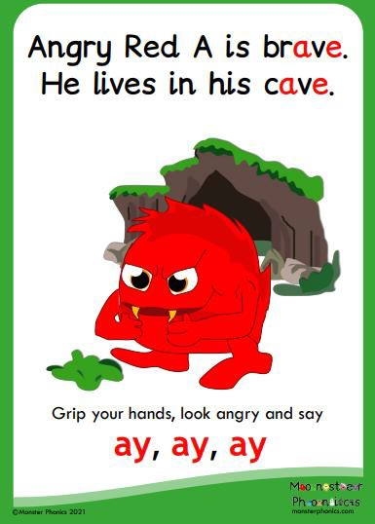
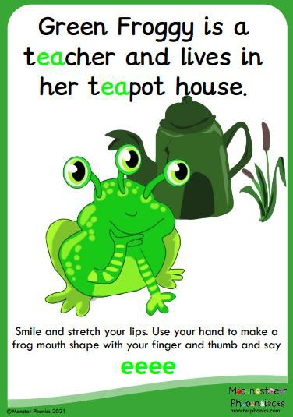

Slide 21

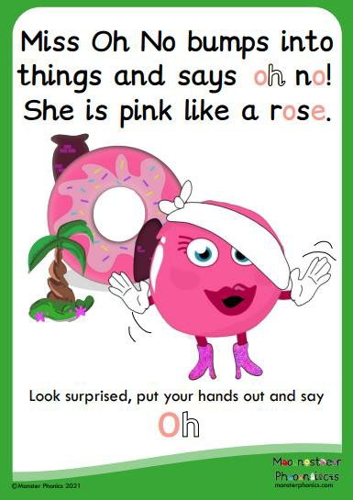

Slide 22

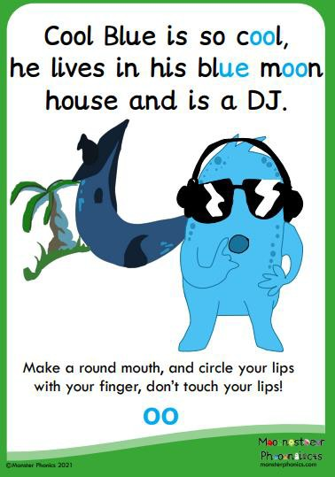

Slide 23
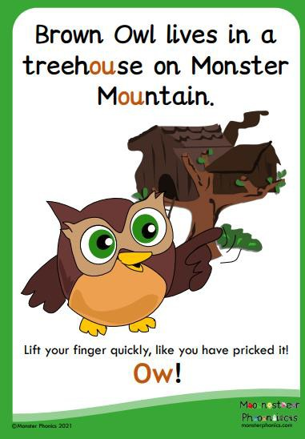
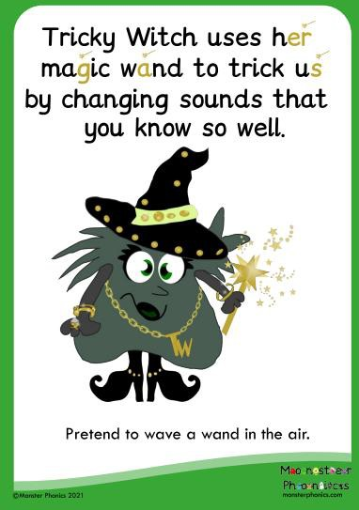

Slide 24


