Slide 1
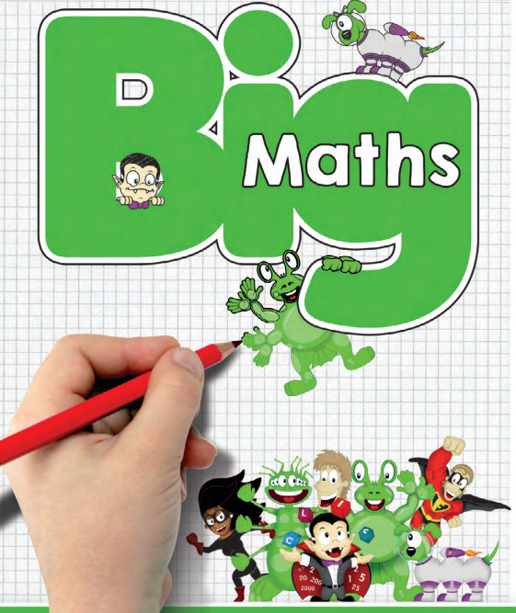

Slide 2
Our Journey so far ...
July 2025 - Baseline assessment
Our current mission: Plugging gaps

Slide 3
CLIC & Learn-It Levels
1 per term
3x full marks on CLIC test to move up (not timed)
Complete Learn-Its in given time to move up (only once)

Slide 4
CLIC
C – Counting
L – Learn Its
I – It’s Nothing New
C - Calculations
Notes:
Each session lasts 20 minutes – 5 minutes on each section

Slide 5
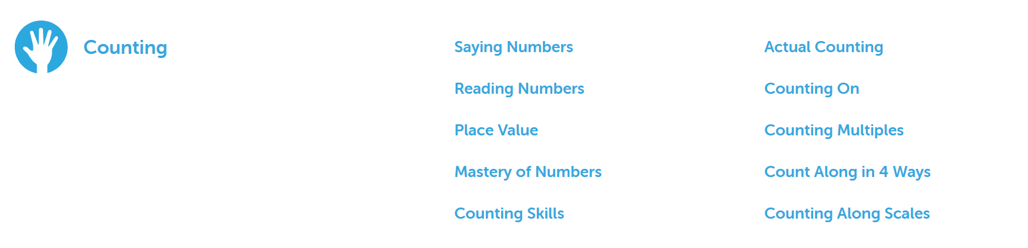

Slide 6
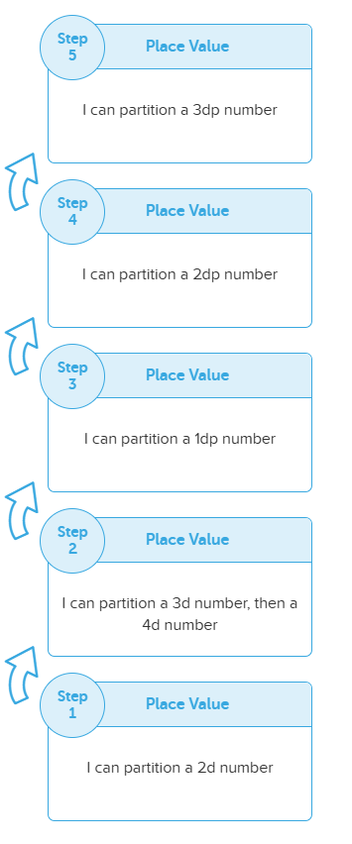
Year 6
Year 1

Slide 7
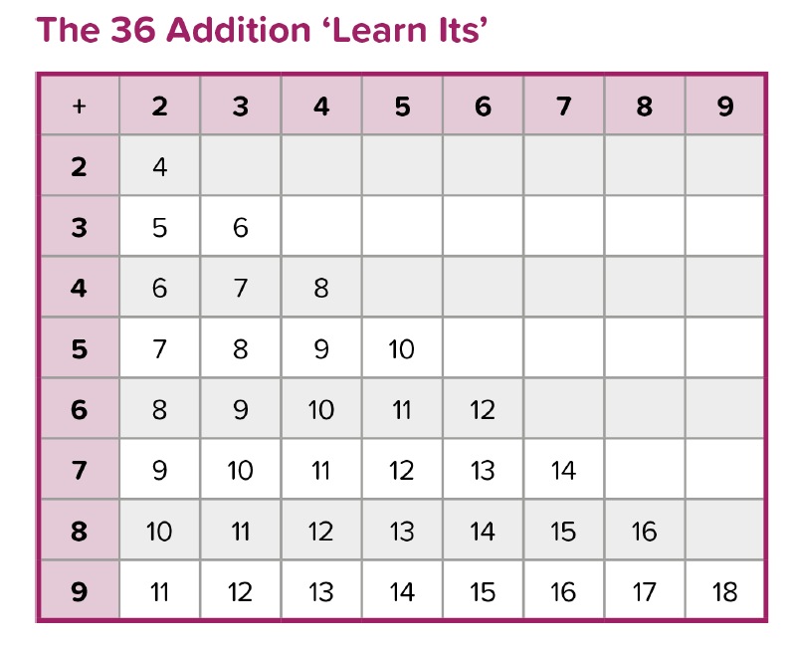
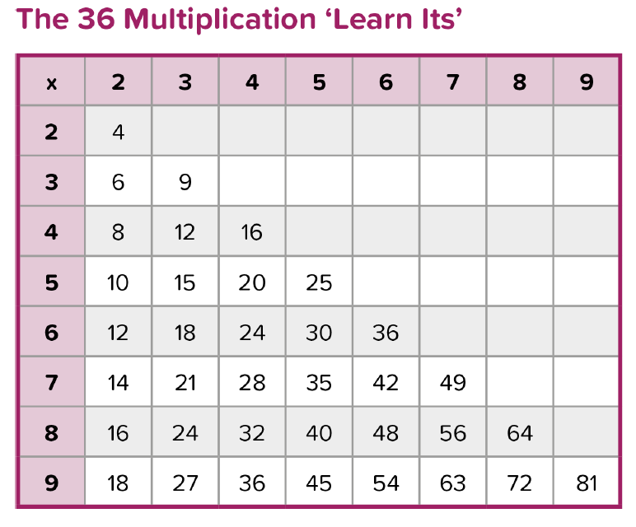
Notes:
Learn Its & Switchers mean children only need to learn 72 facts

Slide 8
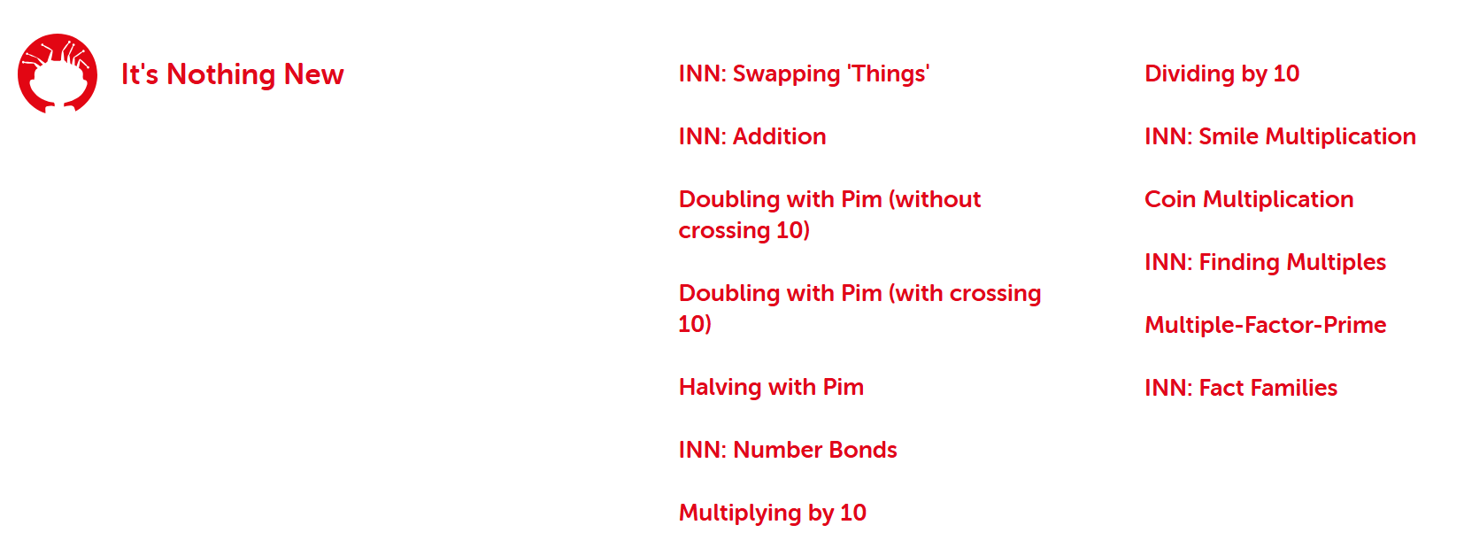

Slide 9
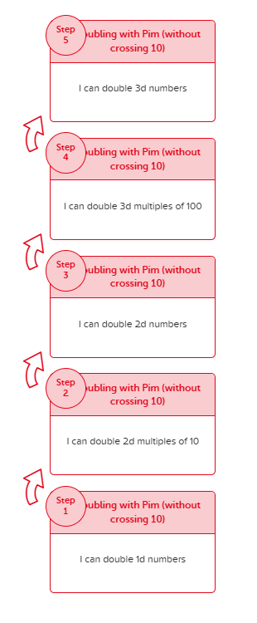
Year 3
Reception

Slide 10
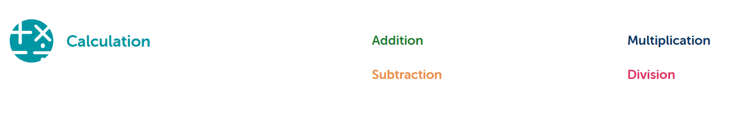

Slide 11
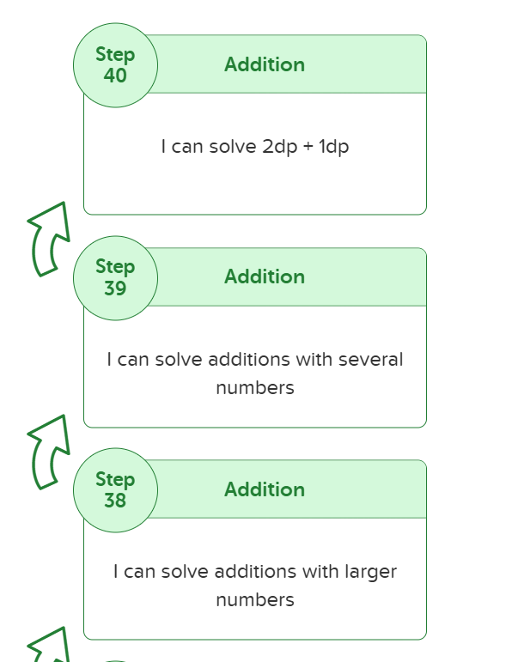
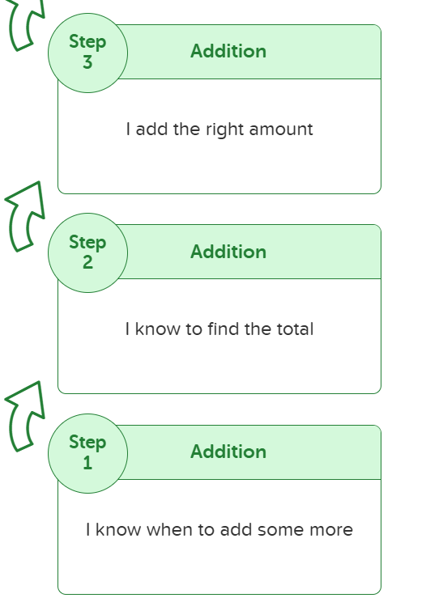
Year 6
Reception
Notes:
Shortened sequence 40 steps altogether!

Slide 12
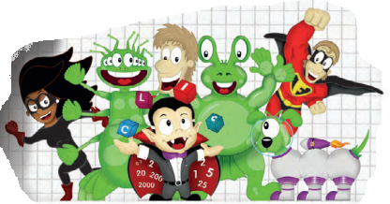
…

Slide 13
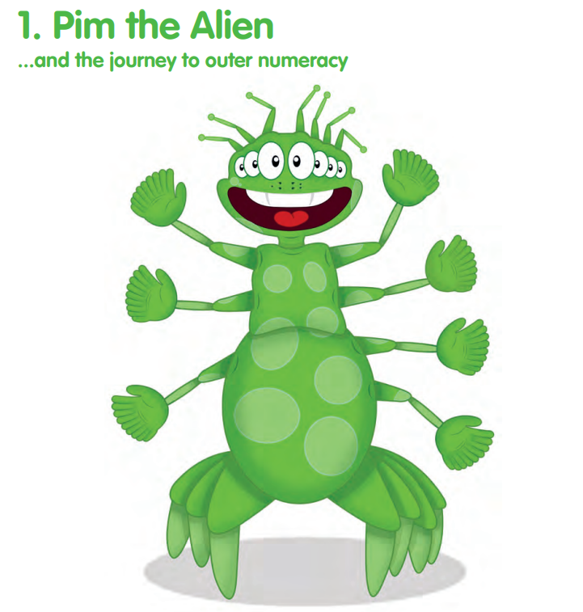
Notes:
3 arms on 1 side, 4 on the other, 7 altogether
Learn that 3 + 4 = 7 and it doesn't matter what the 'thing' is (cm, km, £, …)
This will work for any of their Learn Its (2 + 3 = 5, 2cm + 3cm = 5cm...)
Move on to different numbers: 3 + 4 = 7
30 + 40 = 70
300 + 400 = 700
3 million + 4 million = 7 million
0.3 + 0.4 = 0.7
Then move on to doubling and halving (double 4 is 8, double 40 is 80, double 400 is 800 …)

Slide 14
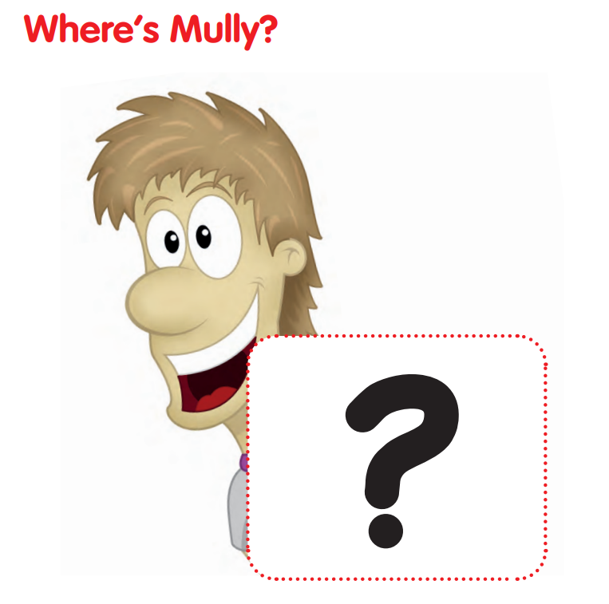
Notes:
Hides behind numbers and gives clues such as:
Hiding behind the biggest multiple of 4 without passing 38

Slide 15
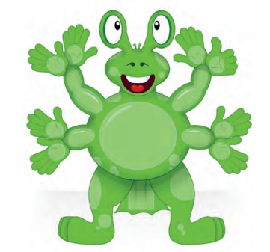
Notes:
Pom lives with Pim on Planet CLIC
Helps children learn the terms multiple, factor, square and prime

Slide 16
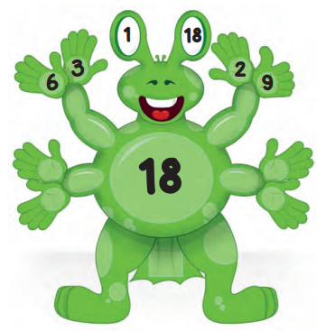
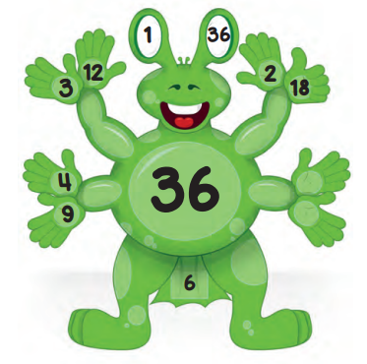
Square numbers & prime numbers
Notes:
Multiple – on stomach
Factors – on hands
1st factor – 1 and itself on eyes. If these are the only numbers on Pom children know it's a prime number
Square numbers – square on his tail

Slide 17

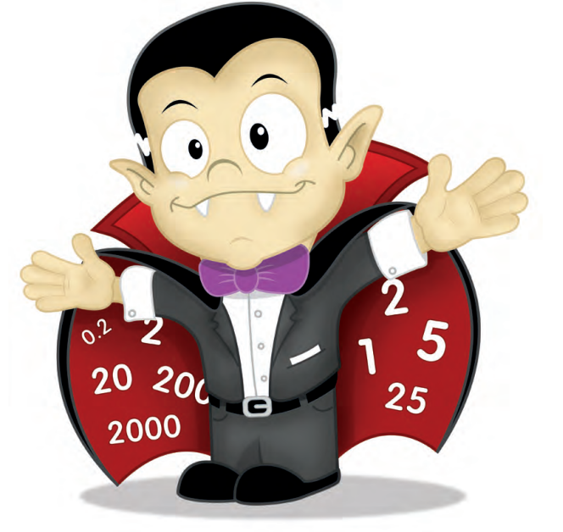
Notes:
Counts in 1s, 2s, 5s and 25s

Slide 18
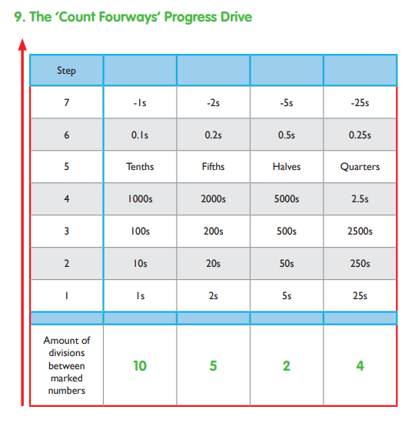
Notes:
Also helps with reading scales.
1-10 scale with 10 divisions – counting in 1s
5 divisions – counting in 2s
2 divisions – counting in 5s
1-100 scale with 4 divisions – counting in 25s

Slide 19
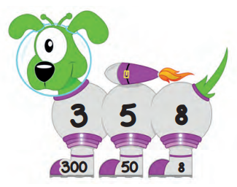

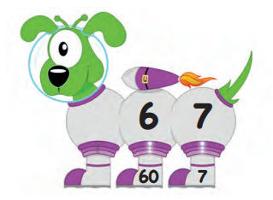
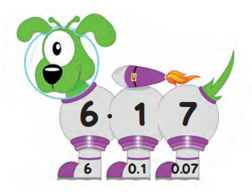
Notes:
Pim's pet, helps with partitioning.
Helps to know the value of each digit.
Whole number is written on body, partitioned on his feet.
Starts with 2-digit numbers, then 3, 4 … before moving on to decimals

Slide 20
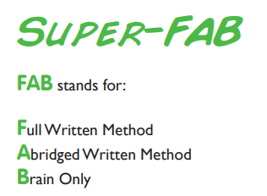

Notes:
Older year groups – when learning is secure
He is really good at focusing on holding numbers in his head, doing something else, and then coming back to those numbers again!

Slide 21


Notes:
Really good at column methods – fast AND careful

Slide 22
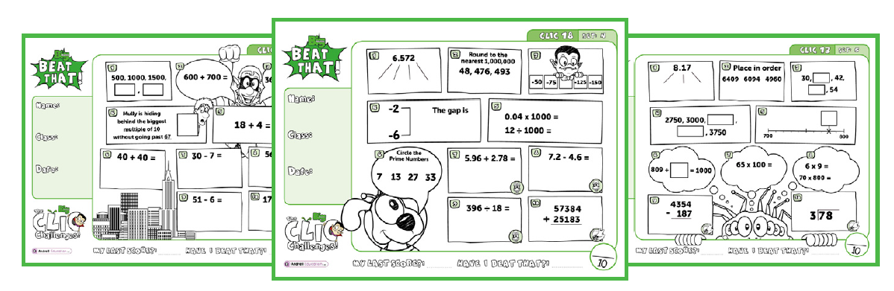
Notes:
CLIC and Learn It tests every Friday
CLIC 6 and below on paper, 7 and above online
CLIC – children need 3x 10/10 to move on
Learn Its –children need all correct within time (only once) to move on

Slide 23
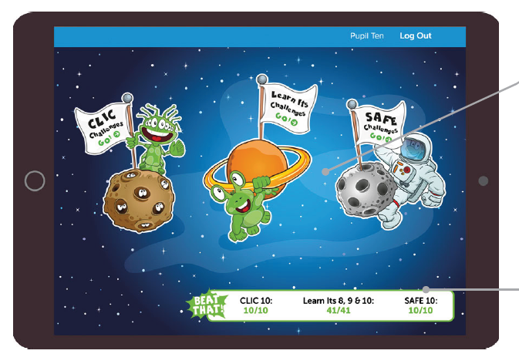

Slide 24
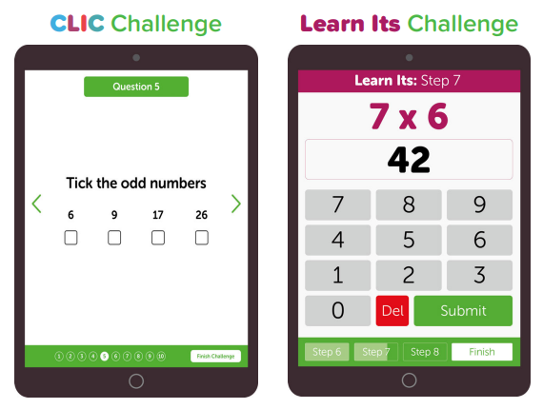

Slide 25
CLIC Level | School Year
1 | Reception, Term 1
2 | Reception, Term 2
3 | Reception, Term 3
4 | Year 1, Term 1
5 | Year 1, Term 2
6 | Year 1, Term 3
7 | Year 2, Term 1
8 | Year 2, Term 2
9 | Year 2, Term 3
10 | Year 3, Term 1
11 | Year 3, Term 2
CLIC Level | School Year
12 | Year 3, Term 3
13 | Year 4, Term 1
14 | Year 4, Term 2
15 | Year 4, Term 3
16 | Year 5, Term 1
17 | Year 5, Term 2
18 | Year 5, Term 3
19 | Year 6, Term 1
20 | Year 6, Term 2
21 | Year 6, Term 3
*Please note, these are just general guidelines
Notes:
Should move 1 CLIC per term. Lots of things to cover in each CLIC even though there are only 10 questions in test.

Slide 26

Home.bigmaths.com
Important to use this at home NOT the Big Maths website that is used in school.
Notes:
1 CLIC level below – as previously mentioned not everything is tested on the CLIC tests. CLIC sessions will provide groundwork for future learning, even if children are not tested on it.
Don't want children learning how to complete a test as it will give false information in school, children will move on and gaps in learning will appear causing problems further on.
Complete test. If child has any questions wrong it switches them to practice mode.
3 sets of online activities – repeat practice, revisit maths and real life maths.
Also resources to download for each of these.
Get full marks on each type of practice to activate your challenge again!
Children will only move on to the next CLIC when they have moved up in school.
Child's teacher can see how the children are doing at home.

