Slide 1

Croeso i Hedgehogs
Blwyddyn 2/3

Slide 2
Staff in Progression Step 2
(Year 1, Year 2 and Year 3)
Teachers:
Mrs Hallam, Mrs Perkins, Mrs Charles and Mrs Reynolds
Teaching Assistants:
Mrs Driscoll, Mrs Pittard and Miss Perry
Other Support Staff/Teachers:
Mrs Evans and Miss Edmunds

Slide 3
Our Town Church Vision
Faith, Love and Learning
These three words reflect the school’s core values and underpin our daily life within the school community. Faith represents the school’s Christian foundation, encouraging pupils to develop respect, reflection and an understanding of spiritual and moral values, while feeling safe to explore their own beliefs and those of others. Love is shown through kindness, care and positive relationships, ensuring that every child feels valued, supported and included within a nurturing environment. Learning highlights the school’s commitment to high expectations, curiosity and lifelong learning, empowering pupils to develop knowledge, skills and confidence to reach their full potential. Together, faith, love and learning guide the school’s ethos, shaping a community where children flourish academically, emotionally and socially.

Slide 4
Our 2026/27 School Improvement Priorities
To introduce and embed a play-based, in-the-moment approach.
To enhance and enrich Science and Technology provision and to raise standards.
To improve standards of written Literacy across the curriculum.
To further develop and expand our provision for vulnerable learners and those with additional learning needs.
To further develop and enrich the children's experience of whole school collective worship.

Slide 5
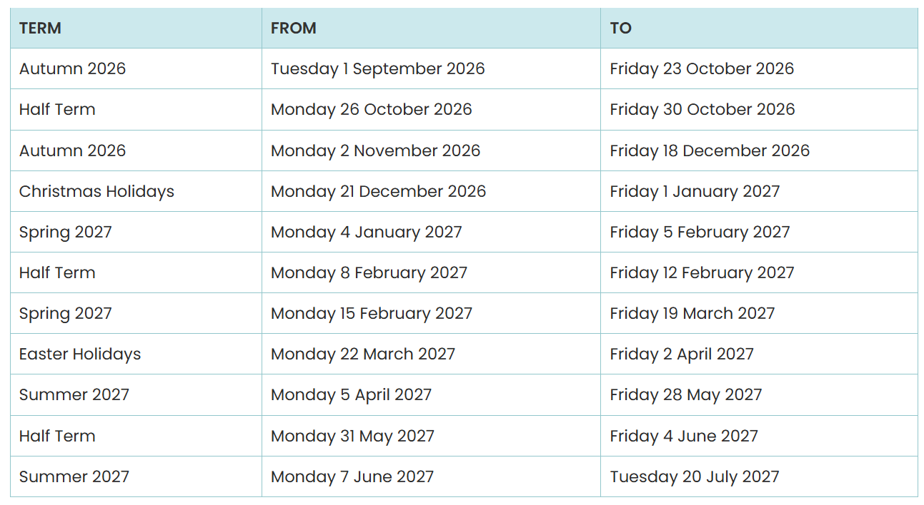
Term Start and Finish Dates

Slide 6
Attendance
Although we understand that children become unwell and we would not want yo to send a sick child to school. Good attendance is a key factor in their progress. A child with an attendance of 90% misses the equivalent of 1 school day every two weeks.
97% attendance | 5 days missed
95% attendance | 10 days missed
90% attendance | 20 days missed
85% attendance | 30 days missed
80% attendance | 40 days missed
75% attendance | 50 days missed
70%attendance | 60 days missed
65% attendance | 70 days missed

Slide 7
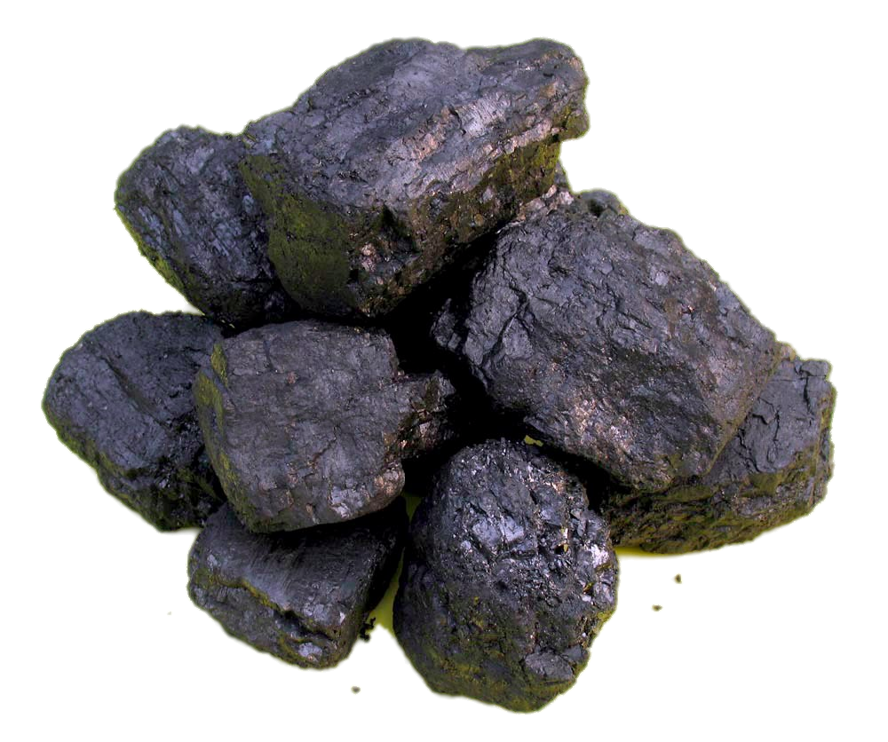
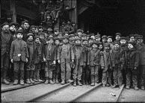

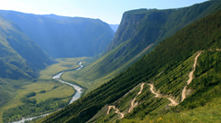
Curriculum Storyboard
Year/ Term: Year 2/3 Autumn Inquiry Title: How have the lives of children living in the Valleys changed since children worked in the mines? |  | Essential Questions: | Why did people mine for coal in the South Wales Valleys? What jobs did children have in the mines of the Welsh Valleys? How does life then, compare to children’s lives in the Valleys now? How did coal mining shape communities in the Valleys?
Why did people mine for coal in the South Wales Valleys? | What jobs did children have in the mines of the Welsh Valleys? | How does life then, compare to children’s lives now in the Valleys? | How did coal mining shape communities like the Valleys?
Why am I learning this?
To understand how the Valleys were rich in coal because millions of years ago plants and forests were buried underground and gradually turned into coal. This made the area valuable and led to towns and communities growing. To learn that was mined because it provided energy for homes, factories, trains and ships. To understand how the mining heritage of the Valleys can still be seen in the landscape, local traditions, museums and family stories. | To understand how children's lives have changed over time Children can compare their own lives with those of children who worked in the mines. To understand how children's lives have changed over time. To develop empathy and fairness. Exploring the difficult and often dangerous work undertaken by young people encourages learners to think about fairness, responsibility and how society should care for children. | To appreciate the opportunities they have today Learners can recognise that children now have the right to attend school, play, rest and learn, whereas many children in mining communities had to work long hours in difficult conditions. To understand how life changes over time By comparing the past and present, learners begin to understand that communities, jobs, technology and people's expectations can change significantly across generations. | To understand how coal mining brought communities together. To discover why choirs became important in the Valleys. To explore the role of faith in mining communities. To recognise how coal mining changed the landscape. To explore whether communities should work together to protect their traditions and heritage?
My experiences as a learner
Examine coal, describing their observations. Explore how coal was formed from ancient plants and forests over millions of years. Investigate maps of South Wales, locating mining areas. Observe local mountains and terraced houses. | Listen to real accounts and stories from mining communities and use these to think about how children felt, what responsibilities they had and what challenges they faced. Examine photographs, artefacts and stories to find out about the different jobs children did in the mines. | Create a timeline to compare my daily routine. Find out what children did for fun in the past and what they do now. Compare children’s right then to now. Discuss children’s rights. Consider what makes a good childhood. | Invite family members or members of the local community to school to talk to the class. Opportunity to ask questions. Invite a local choir to sing traditional Welsh songs. Learn and perform a Welsh song with my class and reflect on how singing together helps people feel part of a community.

Slide 8
Start/End of Day
Morning drop off
Please drop off your children at the main school gate, located on Wind Street. We ask that those parents bringing their children to school in cars be considerate as the entrance can be busy in the mornings and the afternoons. Please also ensure that the bus bay is left unoccupied as this is reserved for the buses bringing our children from further afield. A member of staff will unlock the gate at 8:45am and will be there to welcome everyone until they lock the gate at 9:00am. Promoting independence, the children will line up on the yard at 9:00am and be led into their separate classes and cloakrooms.
Afternoon pick up
The gates will be opened by 3:10pm. Please collect your children from the the external door at the end of our 'Imagination Station' from 3:15pm. If you would like to speak to me, please wait until all children have been safely dismissed. Children not picked up by 15:25 will be taken to the main office as we often have training/meetings that start straight after school and run into the evening. Early collections will always be via the main office.

Slide 9
What should my child bring to school?
School Uniform
This must be worn every day apart from PE days. Please ensure all items are clearly labelled with your child’s name as they can be easily lost or misplaced and this helps us to reunite them with their owner.
Please also ensure that children wear appropriate footwear and bring a coat to school with them. The weather during the Autumn term is always unpredictable and we try to get the children outside at playtime and lunchtime whenever possible. We also engage in outdoor learning opportunities whenever these link to our inquiries and so a warm/ waterproof coat ensures that the children can engage in their learning whilst still being dry and warm.
PE Kit
This should be worn to school on their PE day, which is Wednesday.

Slide 10
What should my child bring to school?
Snack
Children may bring their own healthy snack to eat mid morning - this should be fruit or veg.
Lunch
Our lunch time is 12:00-13:00 and the children go straight out onto the yard. They are then called up to the canteen to have their lunch. Packed lunch and school dinners are both eaten in the canteen and are supervised by our lunchtime supervisors and catering staff. School dinners are prepared on site and the children may order their preferred meal during morning registration. All children in Wales are entitled to a free school meal. Alternatively, you may wish to provide your child with a packed lunch. We respectfully request that packed lunches follow the healthy model we promote as a school and that sweets and sugary treats are NOT included in lunchboxes.

Slide 11
What should my child bring to school?
Water
All children need to bring in a reusable bottle to drink WATER throughout the day, these may be refilled as necessary.
Hats, Scarves, Coats and Gloves
Please ensure your children clothing suitable for the weather, especially a warm, waterproof coat every day - we will continue to spend a lot of time outdoors.
Book Bag
Please bring this into school on your child's reading day. If you are unsure of which day this is, please let me know as I can communicate this to you. Reading at home every week is essential - a little every day goes a long, long way!

Slide 12
Keeping in Touch
Teacher email addresses
We can be contacted via reynoldsa77@hwbcymru.net However, during school hours, I am working with your children and may not pick up your email straight away. Any urgent information or messages should go directly to the school office,
School Website
Information is regularly published on the school website - www.aberdaretownciwprimary.com
Class Dojo
Parents can see the reward points that your child earns in school and can directly message Mrs Walters via ClassDojo. School policy is that teachers cannot be contacted directly via ClassDojo.

Slide 13
Keeping in Touch
Headteacher email address
If there is a query or concern that you feel cannot be addressed by the class teacher, please email Mrs Walters to arrange to discuss this further.
School Office
If you need to inform us that you child is absent from school or you have an urgent message, please contact Miss Carter in the office.
Telephone Number: (01685) 871520
Email address: admin@aberdaretownciwprimary.rctcbc.cymru

Slide 14
Homework and Support
The children work hard during the school day and will be tired when they return home to you. Therefore, we do not set large amounts of homework. We do ask that you read with your child every day as this has a significant impact on their progress across all areas of the curriculum. Phonic sounds and spelling words will be shared via ClassDojo so keep an eye out for those. If there are specific areas of difficulty that require additional practise, your child's teacher will discuss this with you individually.
Many of the children become very interested in their termly inquiries and may wish to further explore these at home.

Slide 15
Questions
If you have any queries or concerns please stay behind after the presentation and take the opportunity to introduce yourself to your child's class teacher. They will be happy to help you.
Many thanks for your time.

